Slide 1
The route from formamide to simple ribozymes – structures and mechanisms from advanced computational studies
Judit E. Šponer,¹ Jiří Šponer¹, Petr Stadlbauer¹ and Ernesto Di Mauro²

Slide 2

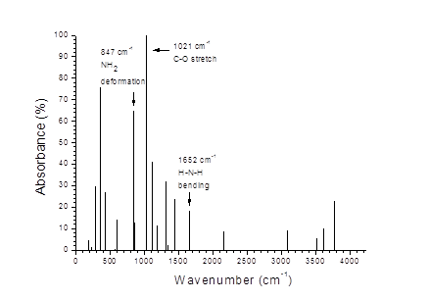
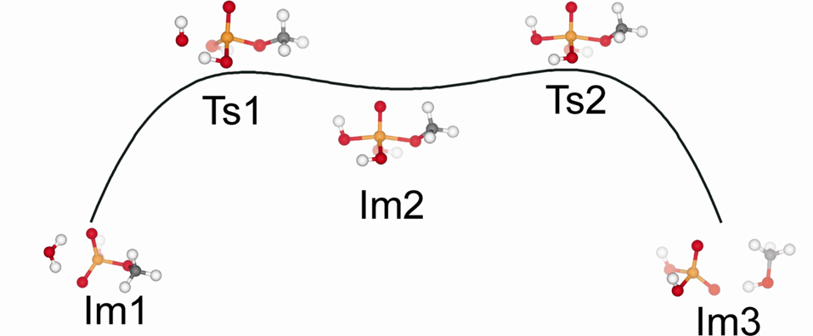
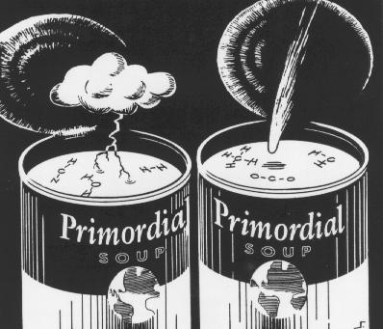
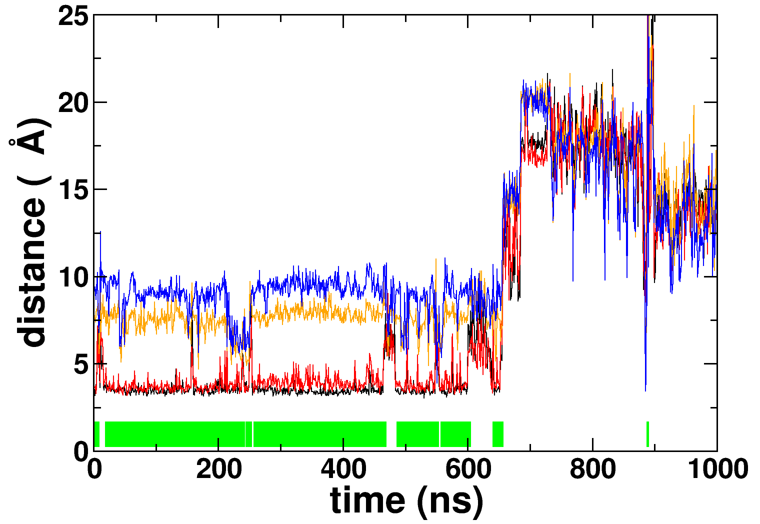
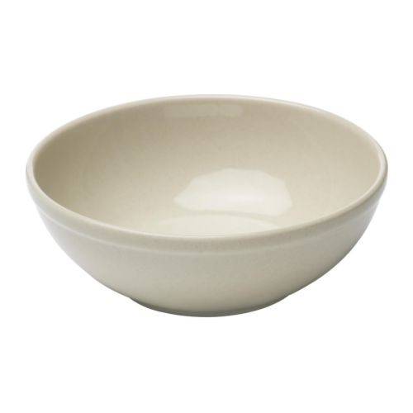
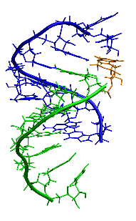
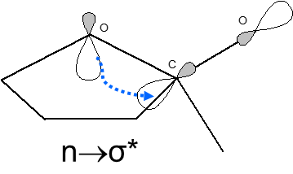
Molecular dynamics (MD) simulations
Force field based representation of the total energy. Information about the time-development of the structure and energy of the studied system.
Quantum chemistry (QC)
Solving the Schrödinger equation to get information about the structure, energy and electronic structure of the studied system.
in silico “cooking”
Commercially available softwares
Aim: to supplement experiments

Slide 3
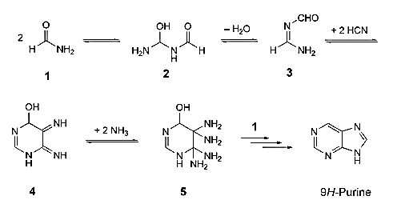
Purine synthesis from formamide:
Saladino, R.; Crestini, C.; Ciciriello, F.; Costanzo, G.; Di Mauro, E., Chem. Biodivers. 2007, 4, 694-720.

Slide 4
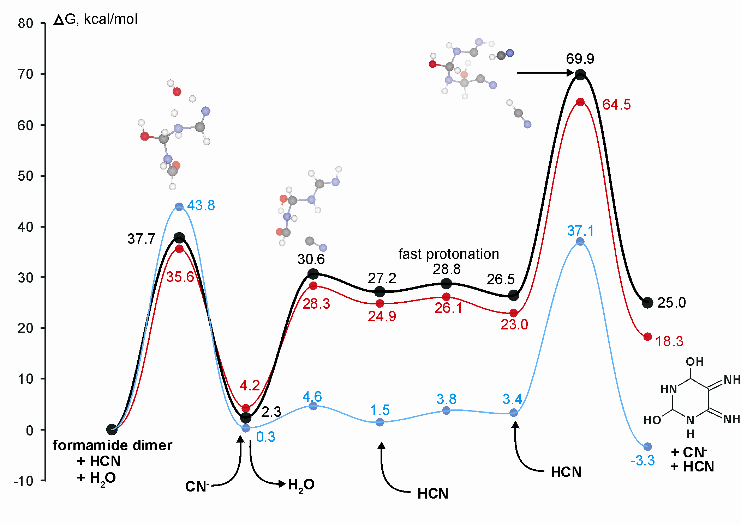
J. E. Sponer et al. J. Phys. Chem. A 2012, 116,720-726
bulk formamide
bulk water
gas-phase
Free energy profile of the reaction route leading to the formation of the 6-membered heterocyclic ring. The energies were computed at B3LYP/6-311++G(2d,2p) level. Bulk solvent effects were treated using the C-PCM approximation.

Slide 5
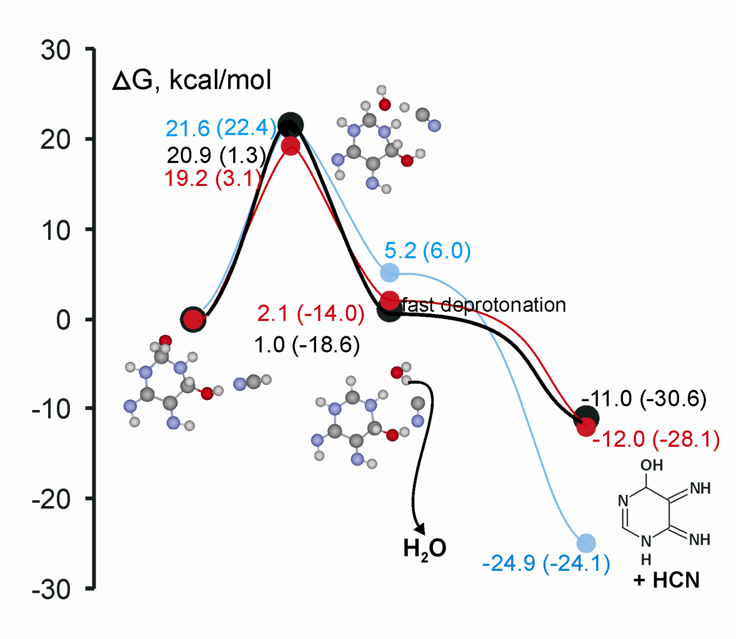
J. E. Sponer et al. J. Phys. Chem. A 2012, 116,720-726
bulk formamide
bulk water
gas-phase
Free energy profile for the dehydration step of the hexahydropyrimidine intermediate. The energies were computed at B3LYP/6-311++G(2d,2p) level. Bulk solvent effects were treated using the C-PCM approximation. Numbers in parenthesis refer to the free energy changes calculated relative to the initial state complex formed from formamide dimer, HCN and water.

Slide 6
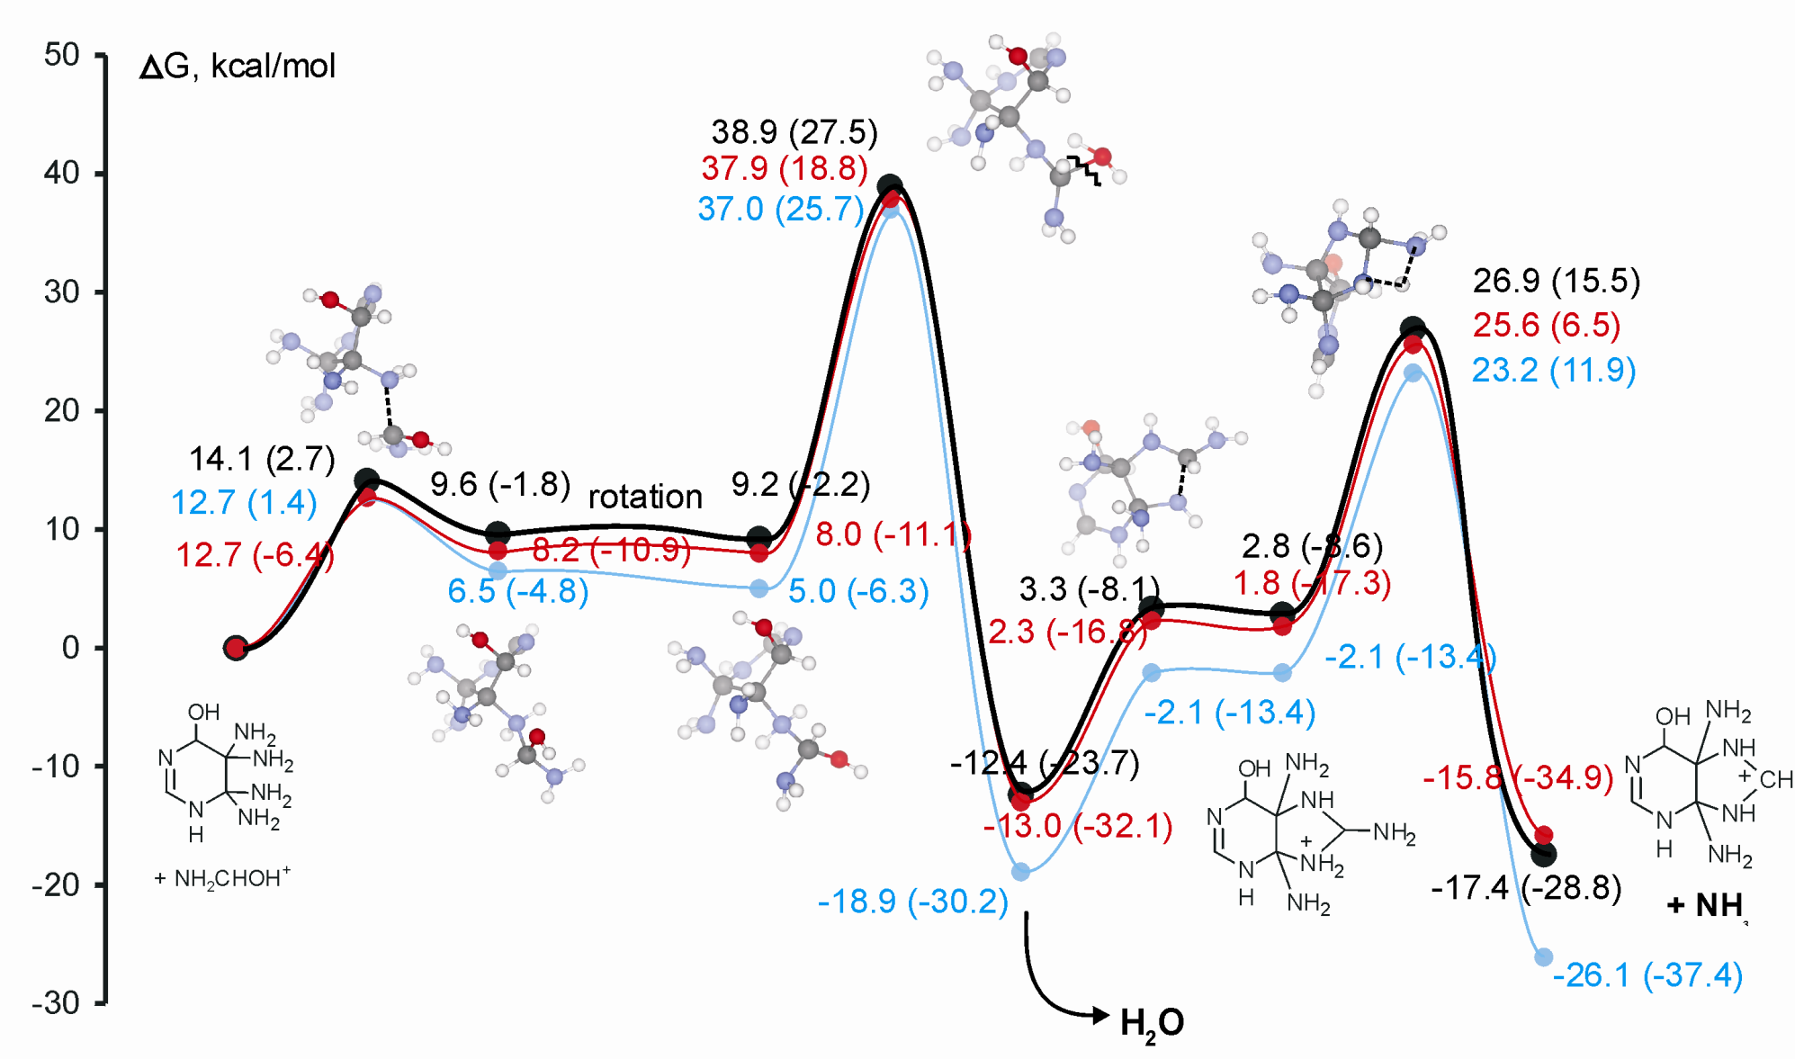
J. E. Sponer et al. J. Phys. Chem. A 2012, 116,720-726
bulk formamide
bulk water
gas-phase
Free energy profile for the formation of purines from the tetrahydro-pyrimidine precursor. The energies were computed at B3LYP/6-311++G(2d,2p) level. Bulk solvent effects were treated using the C-PCM approximation. Numbers in parenthesis refer to the free energy changes calculated relative to the initial state complex formed from formamide dimer, HCN and water.

Slide 7
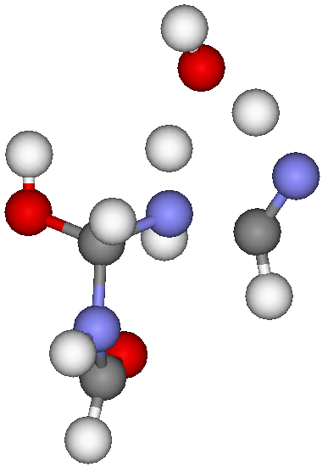
New information inferred from computations
● In HCN-chemistry the synthetic routes leading to purines and pyrimidines are entirely different. In contrast, the formamide-based synthesis of purines may proceed via pyrimidine-intermediates, which enables the simultaneous production of purine and pyrimidine bases.
● Catalytic water molecules
● Catalysis by HCN

Slide 8
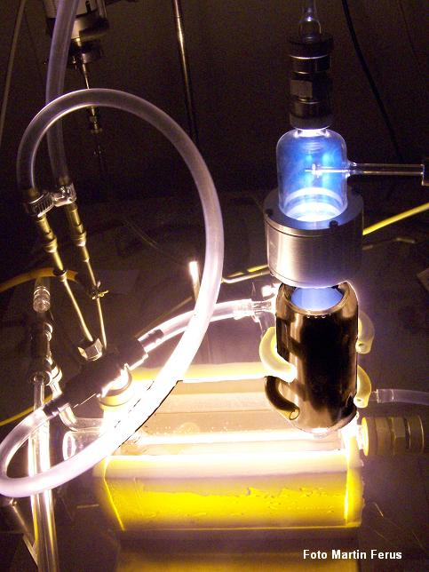


Formamide-based synthesis of nucleobases in a high-energy impact event (i.e. meteoritic impact, simulated with a laser spark)
Formamide is one of the most abundant molecules in the space.
Simulation of meteoritic impact: irradiation with high-power laser → •CN radical.
Formamide + •CN radical → nucleobases
S. Civíš (Prague)
M. Ferus (Prague)

Slide 9
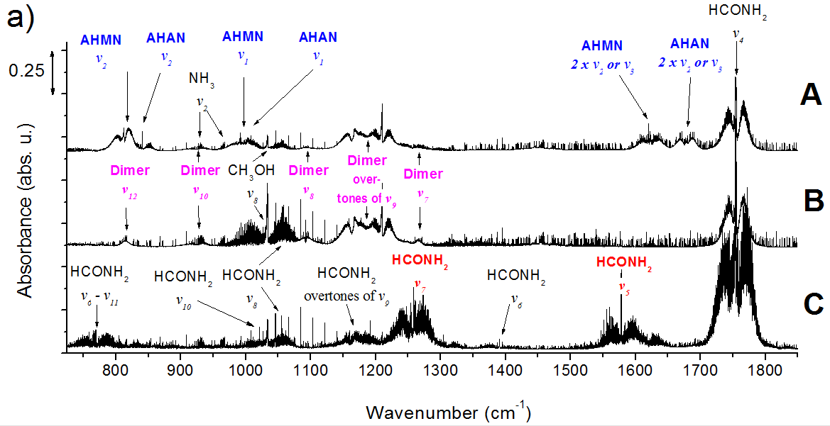
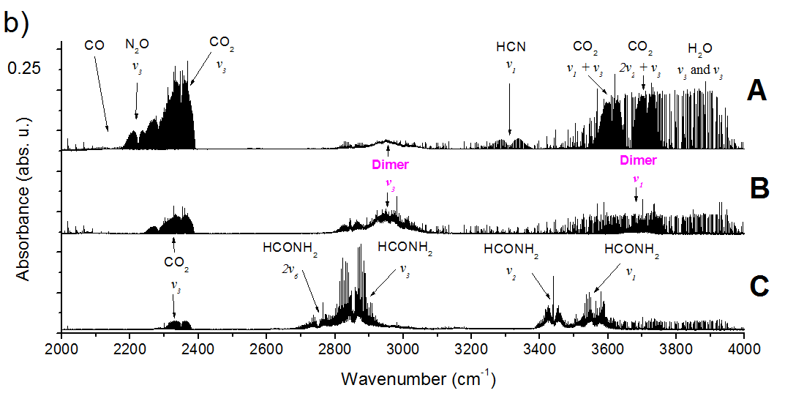
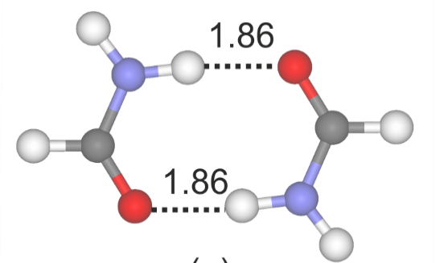
Vapor phase FTIR spectra of liquid formamide and its ice in the MIR and NIR spectral regions.
A: irradiated formamide ice mixed with an FeNi meteorite
B: non−irradiated pure formamide ice
C: gas phase pure formamide sample
M. Ferus, S. Civiš, A. Mládek, J. Šponer, L. Juha, J. E. Šponer, J. Am. Chem. Soc. 2012, 134, 20788−20796.

Slide 10
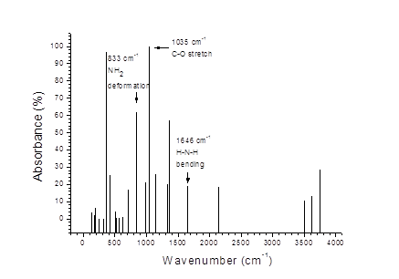
Energy profile of the formation of 2,3-diaminomaleonitrile from the reaction of formamide with CN∙ radical
computed at B3LYP/6−311++G(2d,2p) level. Grey curve: CCSD(T)/6−311++G(2d,2p) benchmark energy
data using the B3LYP/6−311++G(2d,2p) optimized geometries .
M. Ferus, S. Civiš, A. Mládek, J. Šponer, L. Juha, J. E. Šponer, J. Am. Chem. Soc. 2012, 134, 20788−20796.
Energy profile of the formation of 2,3-diaminomaleonitrile from the reaction of formamide with CN∙ radical. The individual reaction steps are highlighted with different colors on the curve computed at B3LYP/6−311++G(2d,2p) level. Grey curve: CCSD(T)/6−311++G(2d,2p) benchmark energy data using the B3LYP/6−311++G(2d,2p) optimized geometries .

Slide 11
Vapor phase FTIR spectra of liquid formamide and its ice in the MIR and NIR spectral regions.
A: irradiated formamide ice mixed with an FeNi meteorite
B: non−irradiated pure formamide ice
C: gas phase pure formamide sample
M. Ferus, S. Civiš, A. Mládek, J. Šponer, L. Juha, J. E. Šponer, J. Am. Chem. Soc. 2012, 134, 20788−20796.

Slide 12
Polymerization of 3’,5’-cGMP
Selectively produces 3’,5’-linkages
3’,5’-cGMP: prebiotic building block, can be synthesized from formamide
pH=9
OH⁻
G. Costanzo, R. Saladino, G. Botta, A. Giorgi, A. Scipioni, S. Pino and E. Di Mauro, Chembiochem, 2012, 13, 999-1008.

Slide 13
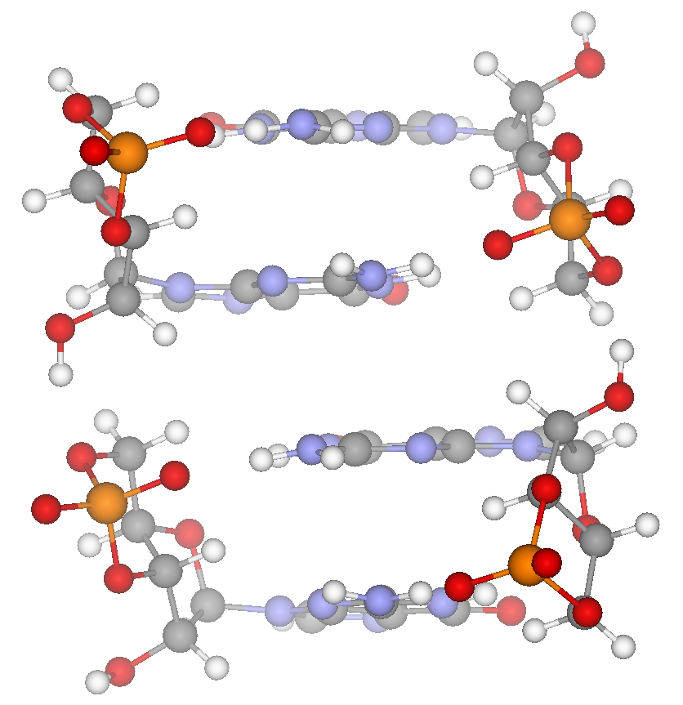
Mechanism of the polymerization of 3’,5’-cGMPs from quantum chemical calculations
(TPSS-D2/TZVP level of theory)

Slide 14
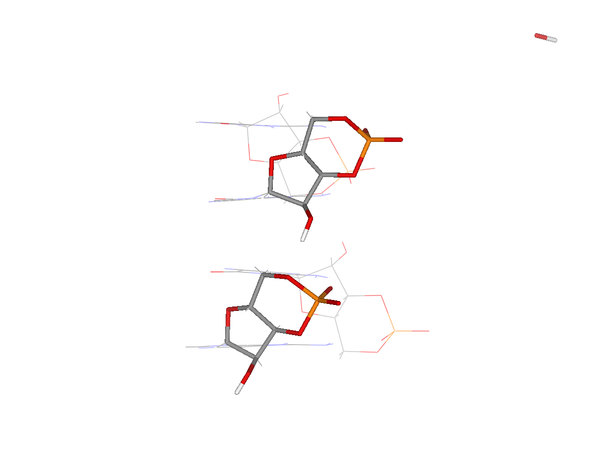
E,
kcal/mol

Slide 15
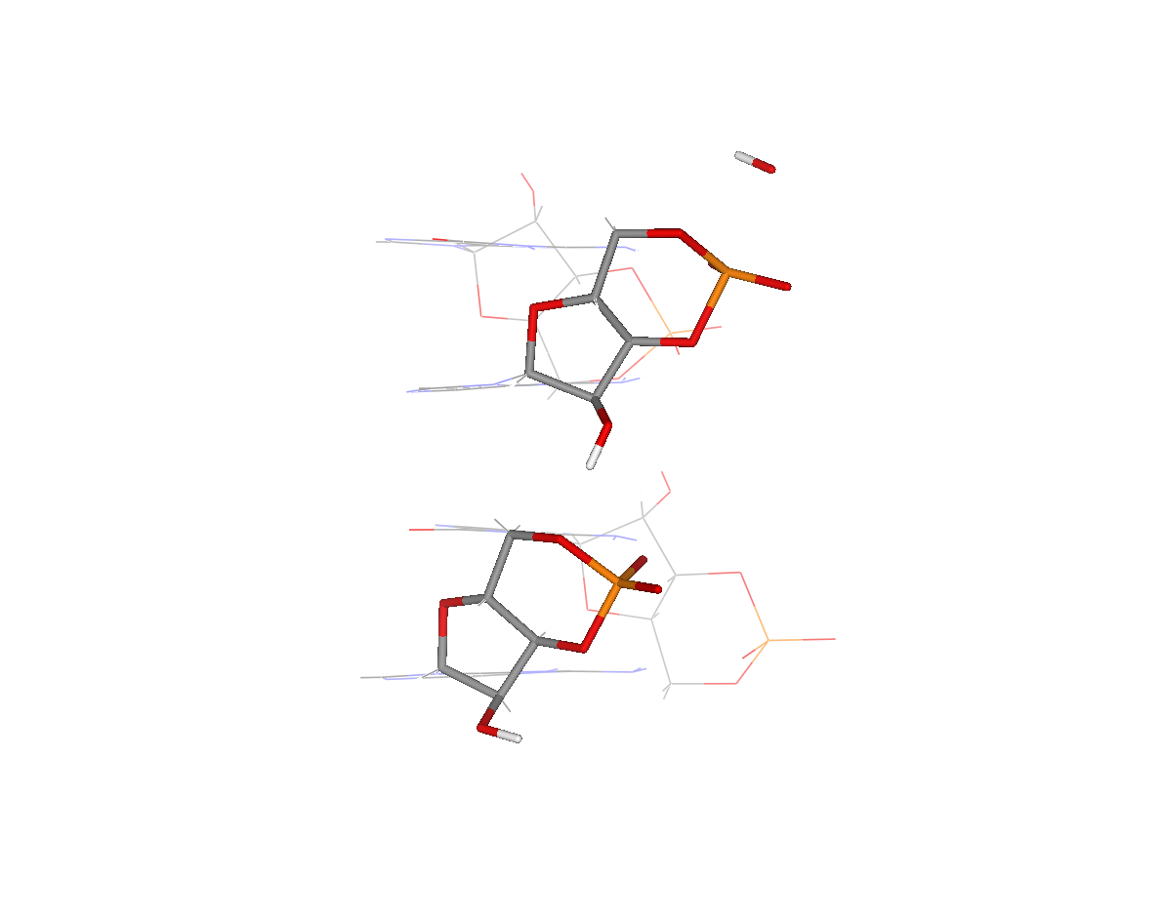
E,
kcal/mol

Slide 16
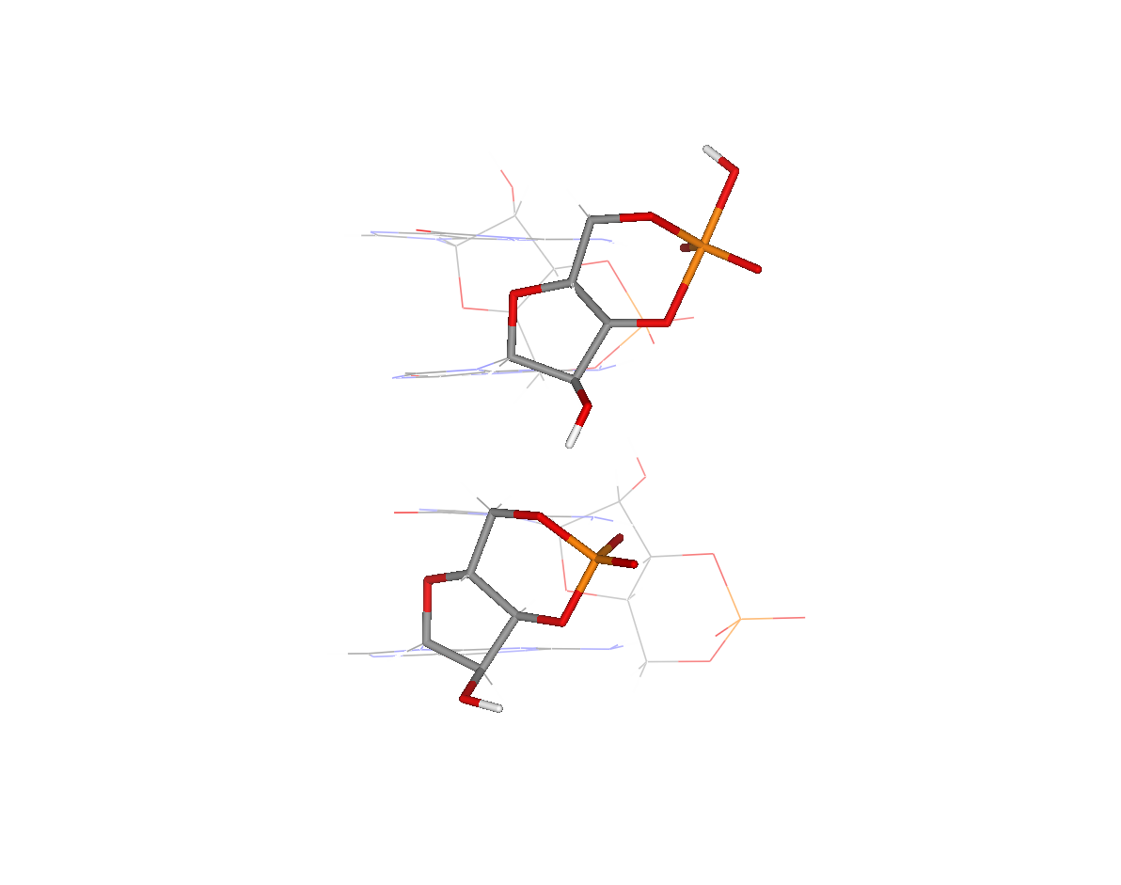
E,
kcal/mol

Slide 17
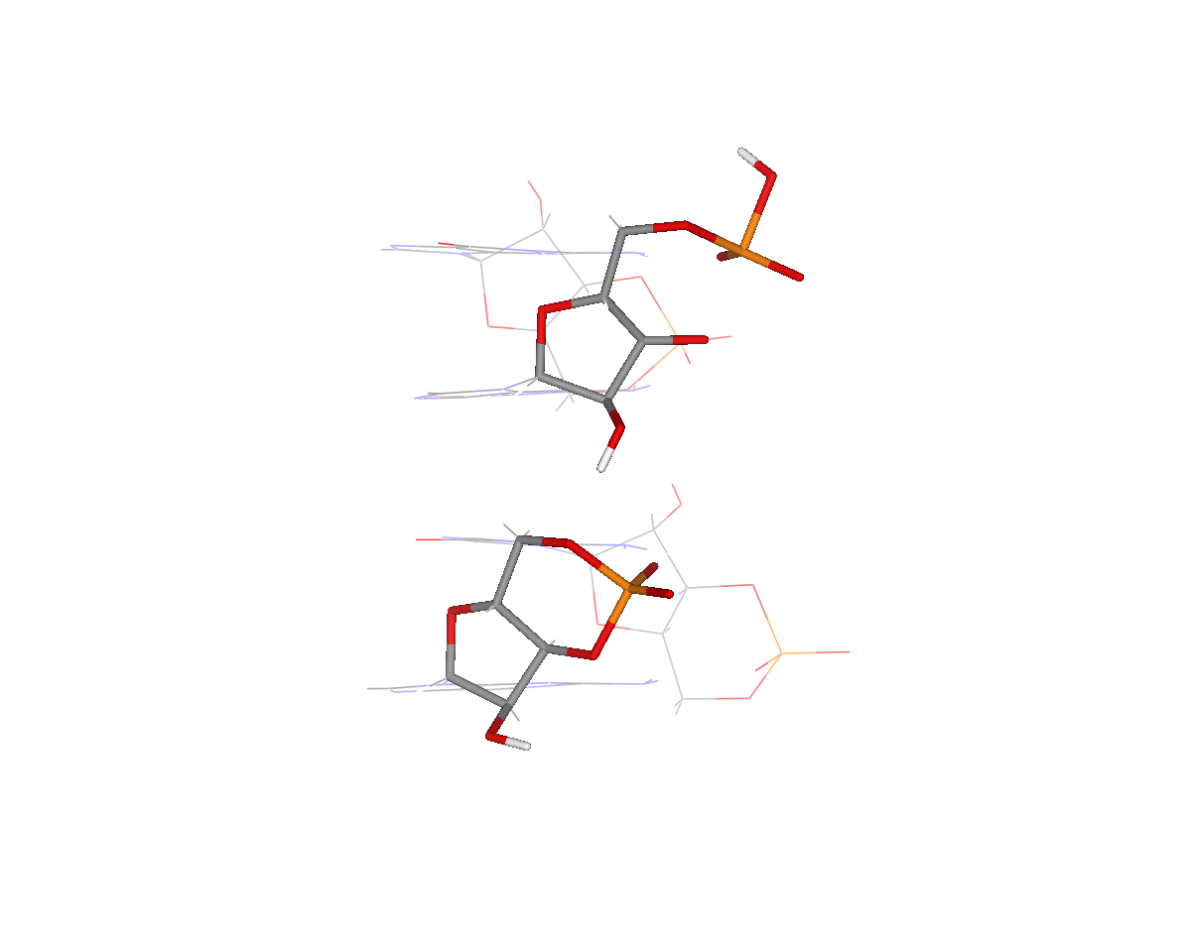
E,
kcal/mol

Slide 18
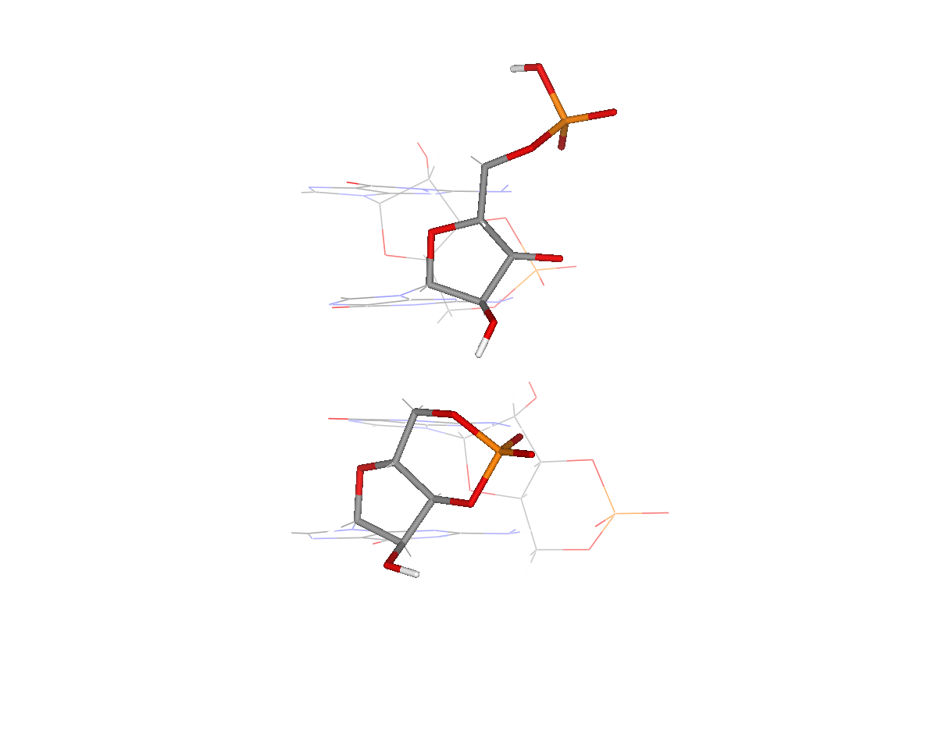
E,
kcal/mol

Slide 19
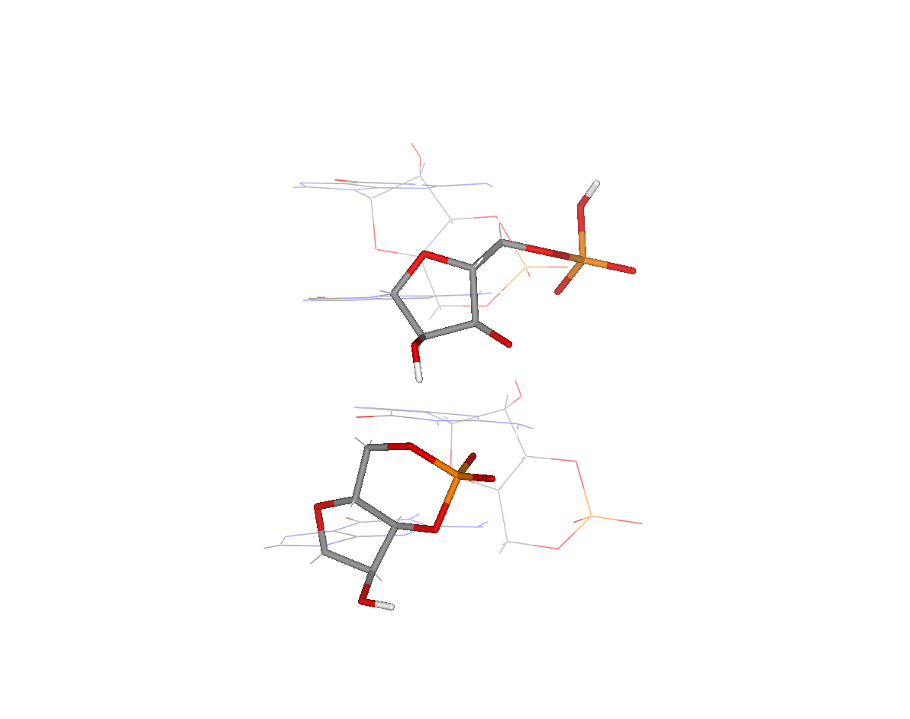
E,
kcal/mol

Slide 20
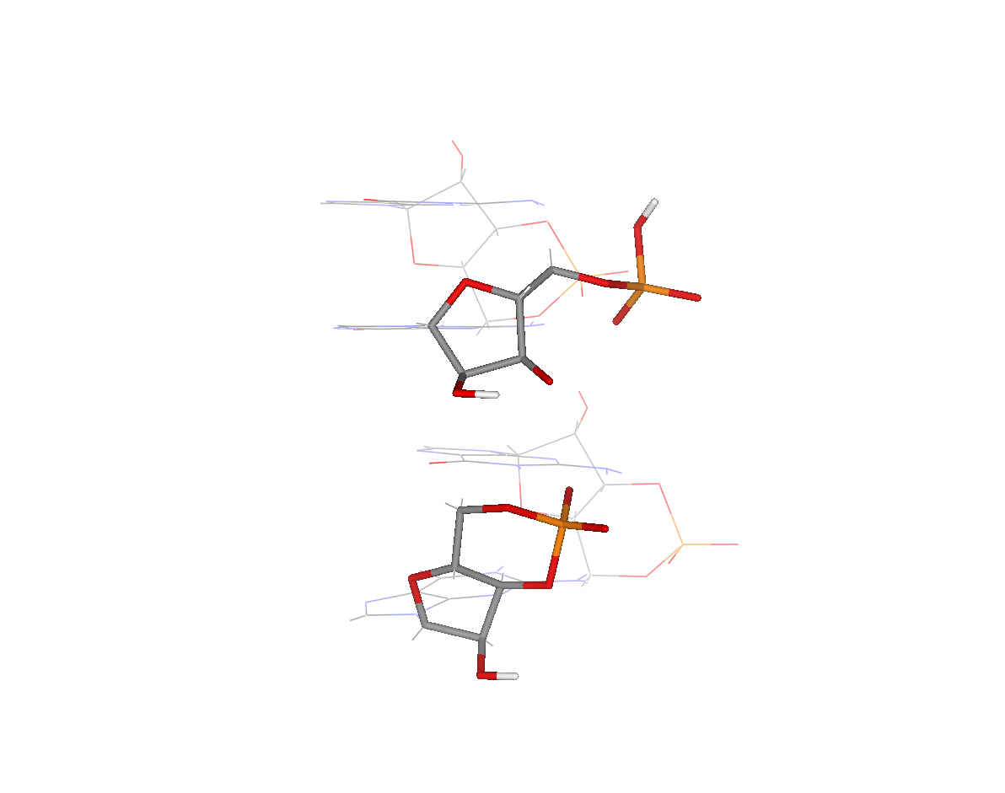
E,
kcal/mol

Slide 21
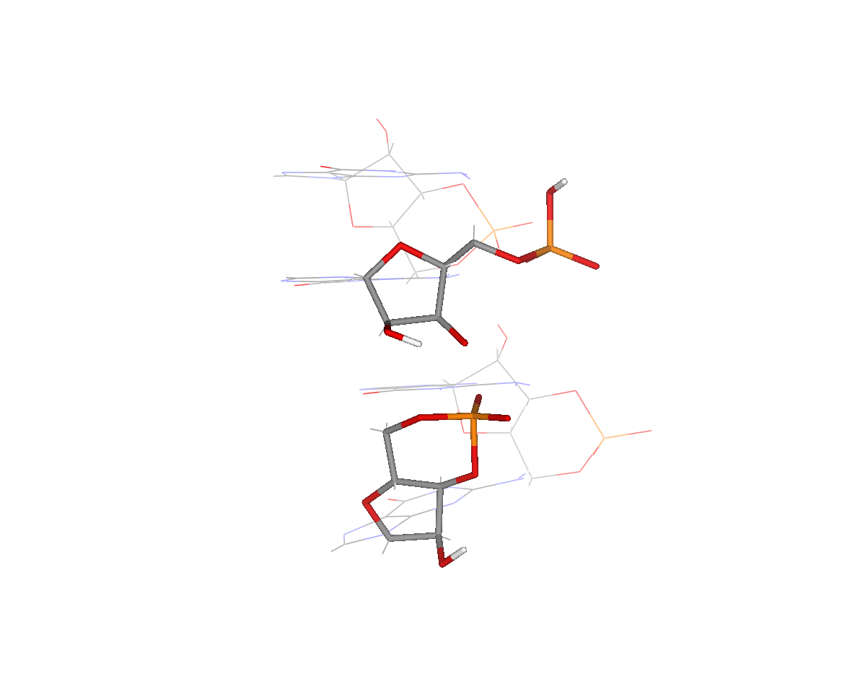
E,
kcal/mol

Slide 22
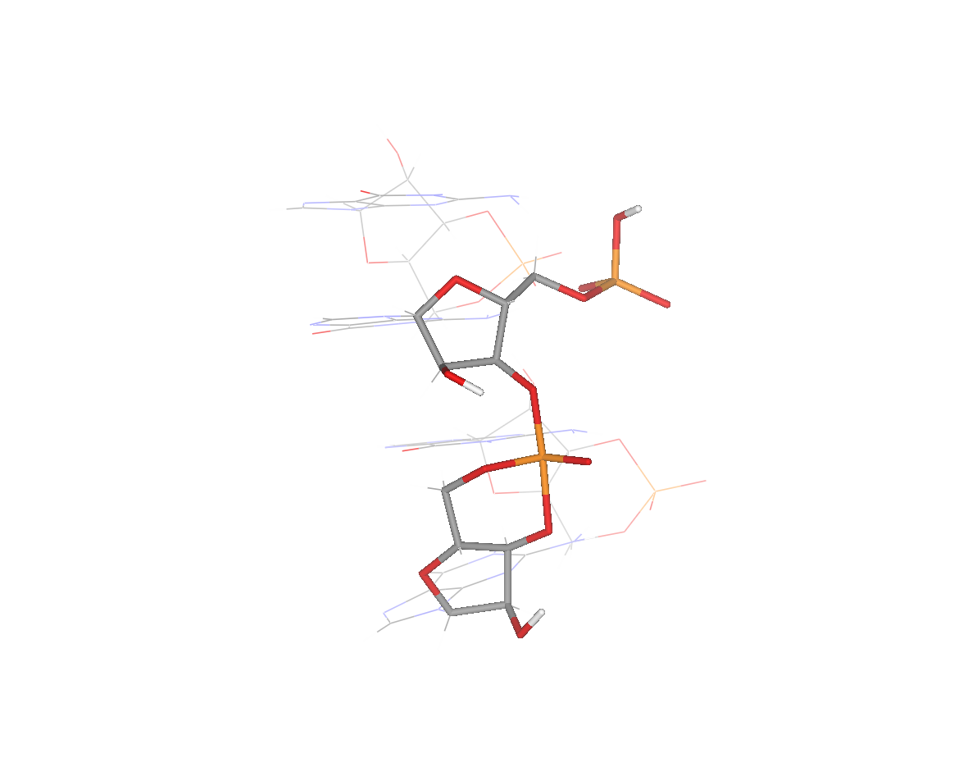
E,
kcal/mol

Slide 23
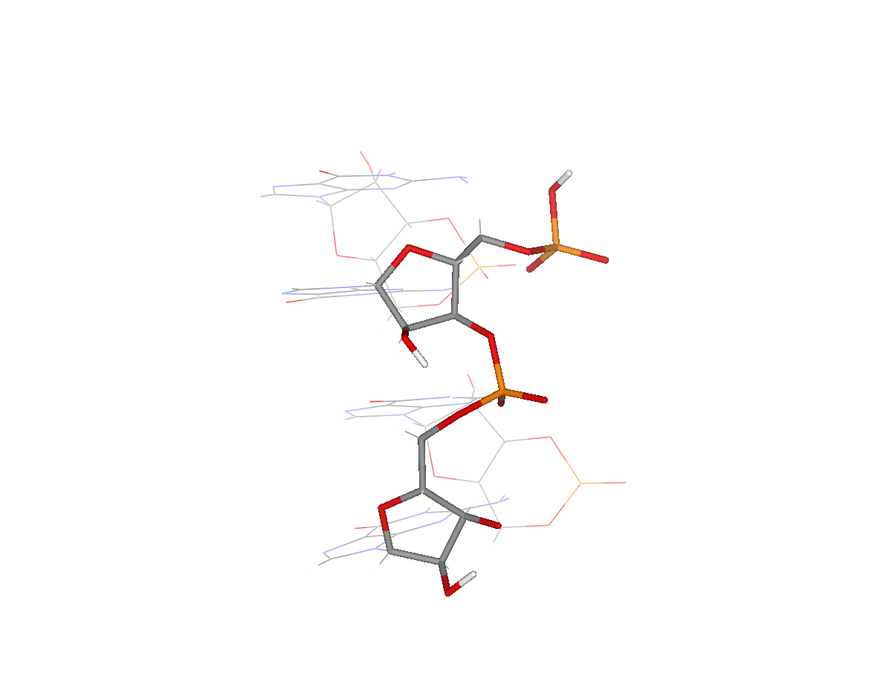
E,
kcal/mol

Slide 24
The “Ligation following Intermolecular Cleavage” (LIC) mechanism
C₂₄
5’
3’-OH
C₂₄G₂₄
ligation
3’
P
P5’
G₂₄
C₂₄
5’
C₂₄ + pG₂₄
3’-OH
+
5’P-G-3’OH
cleavage
C₂₄G₂₃
3’
P
G₂₄
P5’
LIC
C₂₄
5’
C₂₄G
terminal
recombination
3’
P5’
3’-OH
G₂₄
pG
Tetraloops ?
S. Pino, G. Costanzo, A. Giorgi, J. Šponer, J. E. Šponer and E. Di Mauro, Entropy, 2013, 15, 5362-5383.

Slide 25
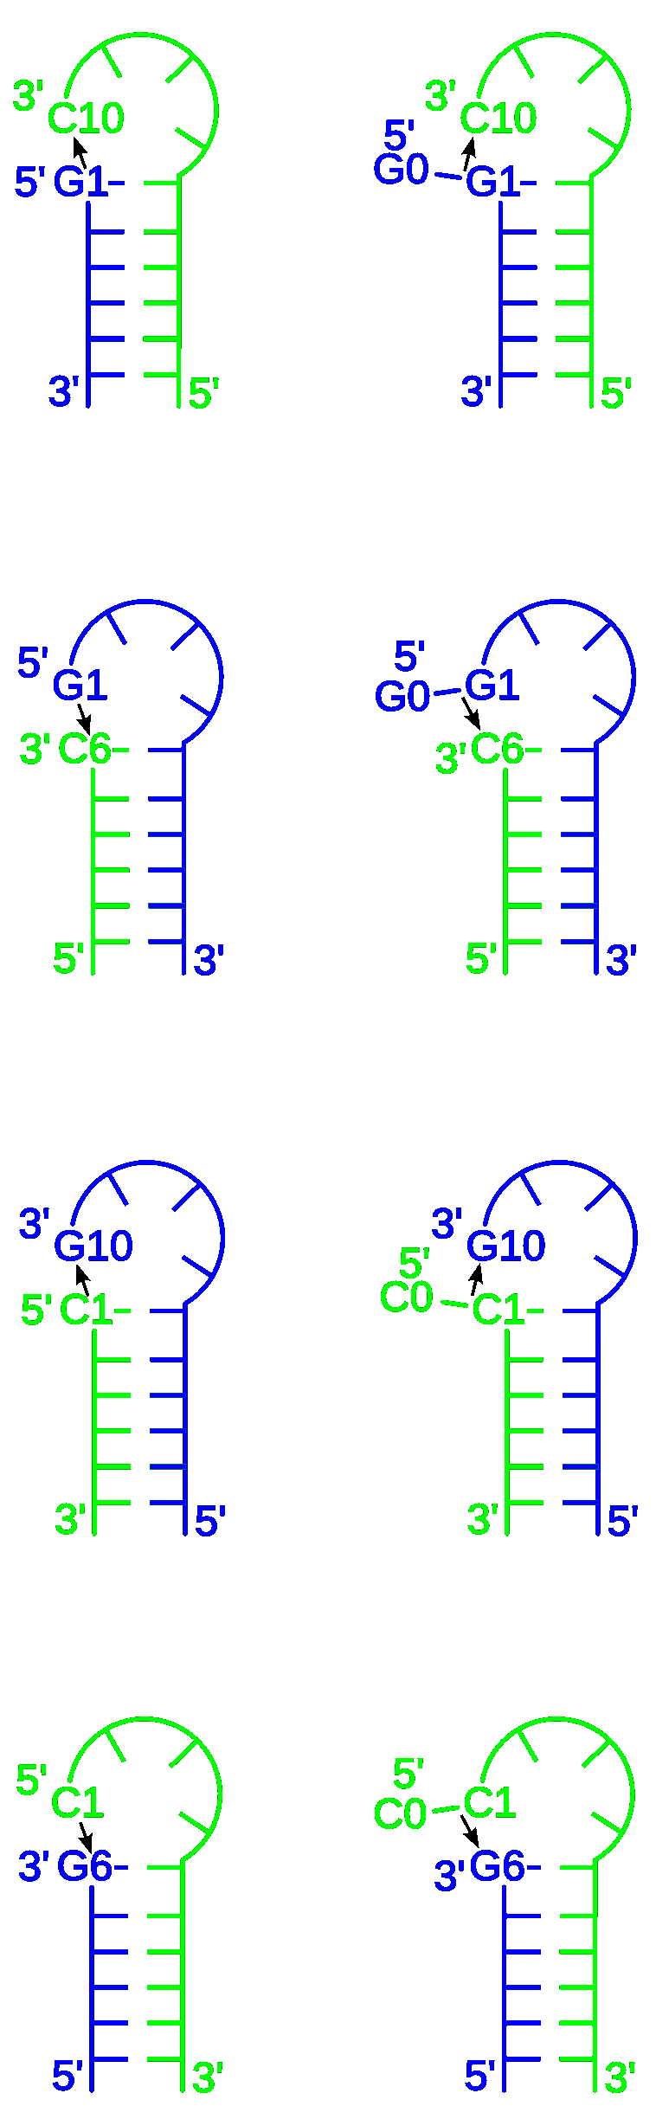
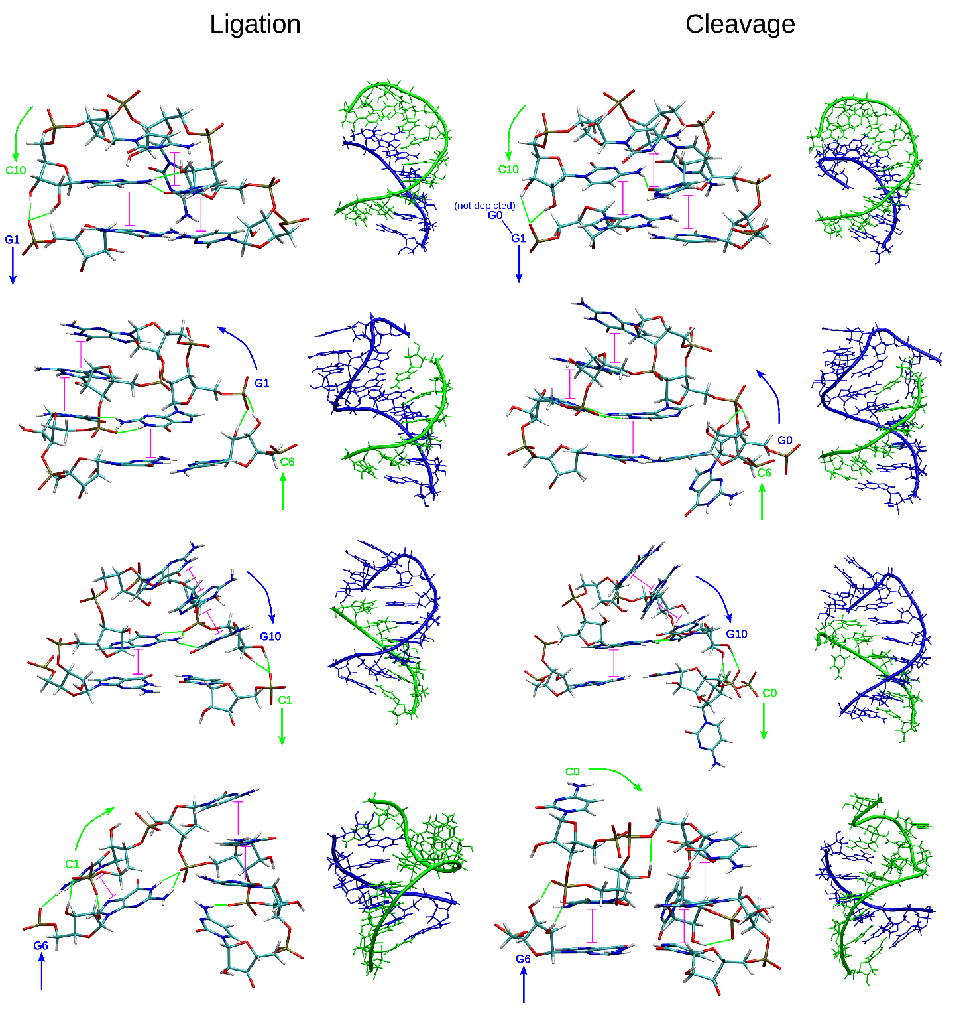
MD-simulations of tetraloop-like geometries enabling ligation and terminal cleavage
Ligation Cleavage Ligation Cleavage

Slide 26
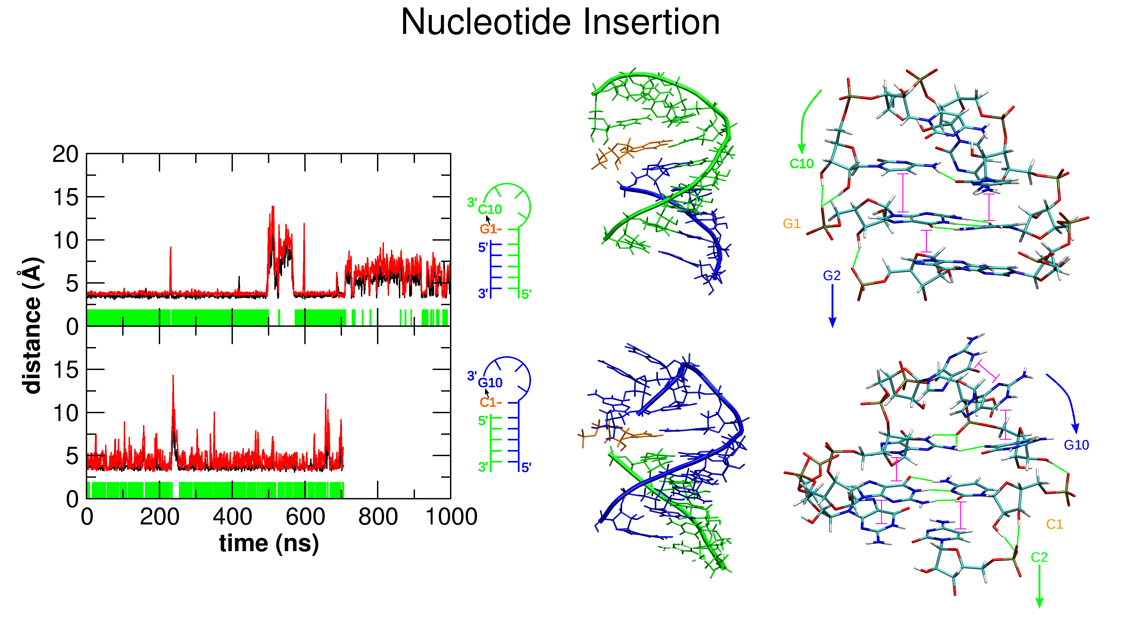
MD-simulations of tetraloop-like geometries enabling terminal recombination

Slide 27
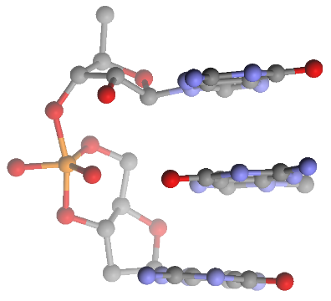
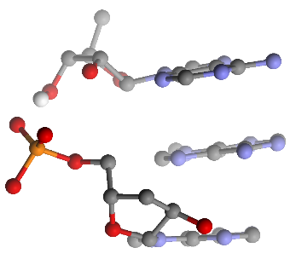
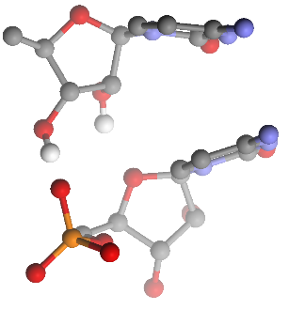
Unifying concept for the origin of catalytically active oligonucleotides from 3’,5’ cGMP and 3’,5’ cAMP
G. Costanzo, R. Saladino, G. Botta,
A. Giorgi, A. Scipioni, S. Pino
and E. Di Mauro, Chembiochem, 2012, 13, 999-1008.
c-GMP polymerization
ligation and catalysis
3’
cGMP
5’
cGMP
5’
C
3’
cGMP
3’
A
C
cGMP
A
C
3’
cGMP
cGMP
C
C
C
C
C
cGMP
A
C
G
C
C
G
cGMP
cGMP
A
C
G
C
G
C
cGMP
cGMP
A
C
G
C
G
cGMP
cGMP
3’
A
C
G
C
G
S. Pino, G. Costanzo, A. Giorgi, J. Šponer, J. E. Šponer and E. Di Mauro, Entropy, 2013, 15, 5362-5383.
5’
C
cGMP
3’
cGMP
5’
A
C
G
C
G
cGMP
5’
5’
3’
5’
3’
5’
S. Pino, G. Costanzo, A. Giorgi and E. Di Mauro, Biochemistry, 2011, 50, 2994-3003.
templated
non-templated
templated
3’
A
3’
A
A
A
C
C
A
A
C
C
stacking
cAMP
AMP
C
G
cAMP
AMP
C
G
A
A
C
G
A
A
C
G
3’
A
A
5’
5’
5’
S. Pino, F. Ciciriello, G. Costanzo and E. Di Mauro, J. Biol. Chem., 2008, 283, 36494-36503.

Slide 28
Acknowledgement
Prof. Ernesto Di Mauro, Rome, Italy
Dr. Samanta Pino, Rome, Italy
Dr. Alessandra Giorgi, Rome, Italy
Dr. Giovanna Costanzo, Rome, Italy
Dr. Martin Ferus, Prague, Czech Republic
Prof. Svatopluk Civíš, Prague, Czech Republic
Prof. Jiří Šponer, Brno, Czech Republic
Mr. Petr Stadlbauer, Brno, Czech Republic
GAČR grant No. P208/12/1878

