Slide 1
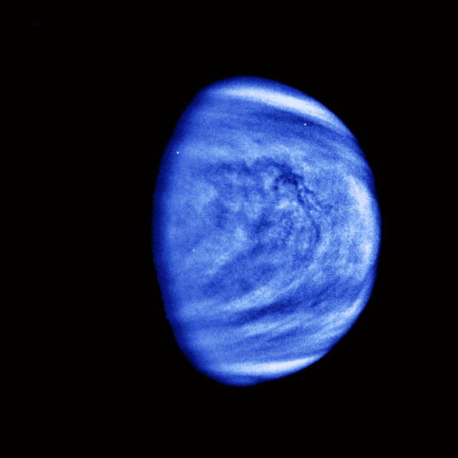
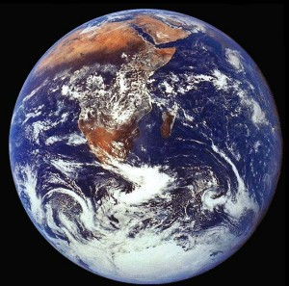
How the Search for Earth-like Planets Around Other Stars can Inform Studies of the Origin of Life
James Kasting
Department of Geosciences
Penn State University

Slide 2
Two quick thoughts about early atmospheric composition and climate, inspired by talks earlier in the meeting
First, the prebiotic atmosphere was not highly reducing, but CO could have been an important source of metabolic energy for early life ⇒

Slide 3
CO is way out of equilibrium with H₂ in early atmosphere models because
  It is produced by photolysis of CO₂
  CO does not recombine rapidly with atomic O
  H₂ escapes to space, whereas CO does not
Fig. 1

Slide 4
Water-gas shift reaction
Energy is therefore available from the water-gas shift reaction
CO + H₂O → CO₂ + H₂
For a ‘standard’ prebiotic atmosphere (previous slide) the Gibbs free energy for this reaction is
By comparison, the free energy needed to form ATP from ADP is 35.6 kJ/mol. Many chemotrophic anaerobes can utilize reactions yielding 10-15 kJ/mol
∴ This reaction could have been utilized as a source
of metabolic energy by early organisms

Slide 5
Second, it would probably be a mistake to think that the early Earth was uniformly hot…

Slide 6
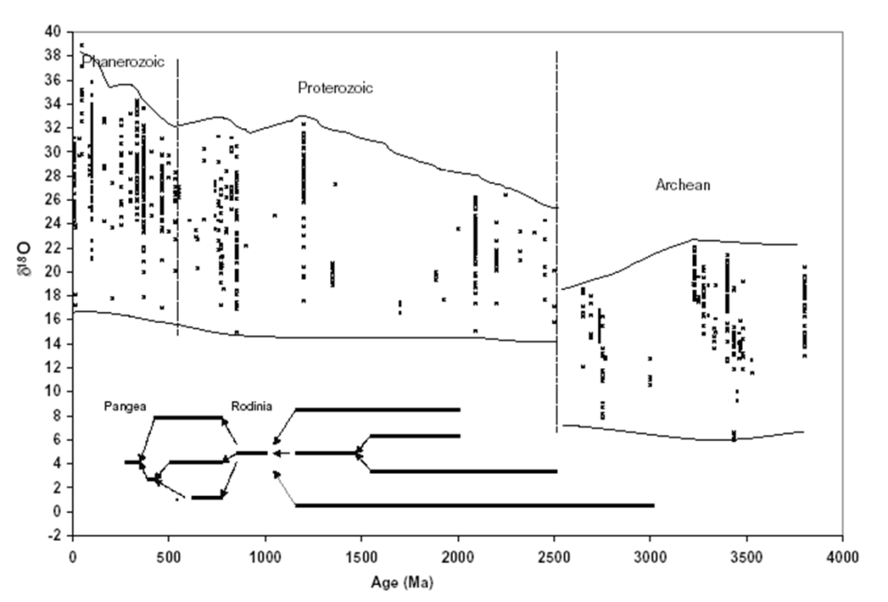

Paleotemperatures from O isotopes in ancient cherts
O isotopes in ancient cherts (SiO₂) and carbonates have been used as evidence for warm surface temperatures early in Earth history
Taken at face value, the chert data suggest temperatures of 70±15ºC at 3.5 Ga
P. Knauth, Paleo³ 219, 53 (2005)

Slide 7
Nature (2008)
The inferred high temperatures from O isotopes are supported by data on ‘resurrected proteins’ (various EF proteins) obtained by sequencing various microorganisms, identifying ancient genes, synthesizing the corresponding proteins, and measuring their melting points
EF proteins
Chert data
Gaucher et al. (2008)

Slide 8
But the conclusion that the Archean Earth was hot is in direct conflict with the glacial record ⇒

Slide 9
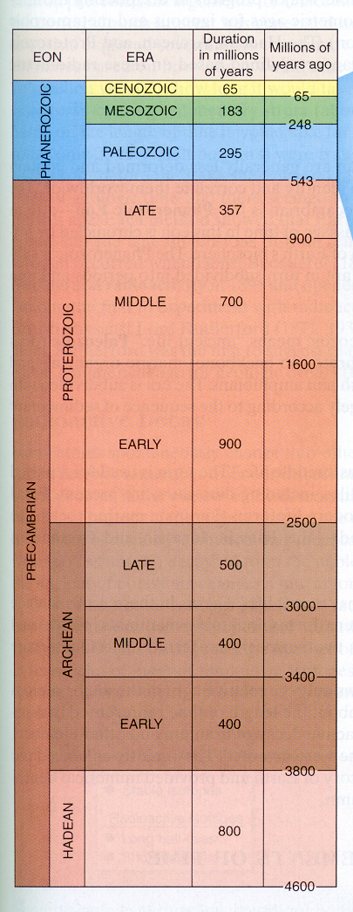
Geologic time
First shelly fossils (Cambrian explosion)
Snowball Earth ice ages
Warm?
Ice age
Rise of atmospheric O₂ (Ice age)
Ice ages
The Hadean and early Archean could
have been warm, but the late Archean
and early Proterozoic were probably
cool

Slide 10
OK, now back to my advertised topic…

Slide 11
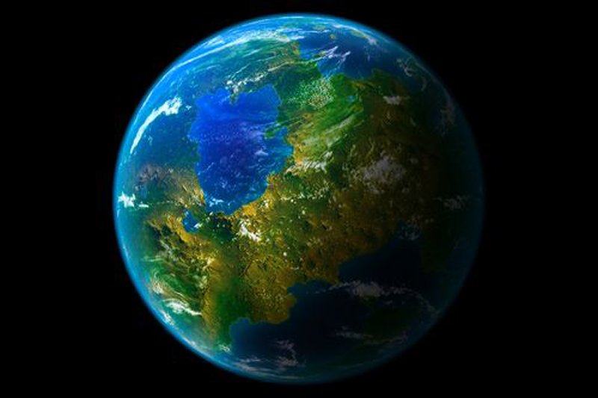
How often has life arisen?
Perhaps the most fundamental question about the origin of life is: Did it happen more than once?
  Answering this question would help us decide whether the origin of life is likely or unlikely
We can answer it either by finding life within our own Solar System or by looking for evidence of life on planets around other stars
http://massufosightings.blogspot.com/

Slide 12
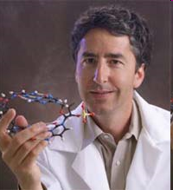
What is life?
If we are going to search for life on other planets, we first need to decide what we are looking for
One definition: “Life is a self-sustained chemical system capable of undergoing Darwinian evolution”
--Jerry Joyce
This definition, however, is better suited to looking for life in a laboratory experiment than for searching remotely on planets around other stars
Jerry Joyce, Salk Institute

Slide 13

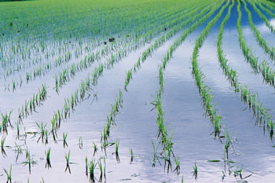
Looking for life via the by-products of metabolism
Green plants and algae (and cyanobacteria) produce oxgyen from photosynthesis:
CO₂ + H₂O → CH₂O + O₂
Methanogenic bacteria produce methane
CO₂ + 4 H₂ → CH₄ + 2 H₂O
CH₄ and O₂ are out of thermodynamic equilibrium by 20 orders of magnitude!* Hence, their simultaneous presence is strong evidence for life
O₂
CH₄
*As first pointed out by James Lovelock (Nature, 1965)

Slide 14
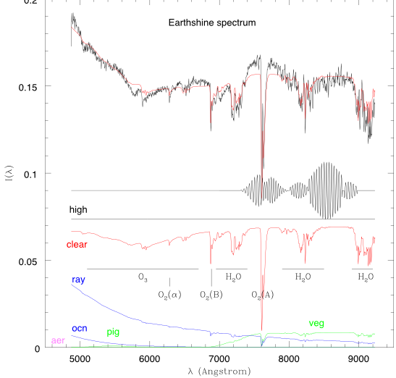
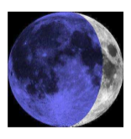
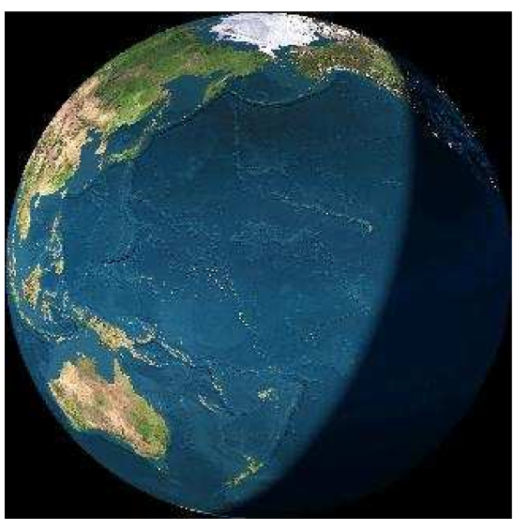
Visible spectrum of Earth
Integrated light of Earth, reflected from dark side of moon: Rayleigh
scattering, chlorophyll, O₂, O₃, H₂O
Ref.: Woolf, Smith, Traub, & Jucks, ApJ 2002; also Arnold et al. 2002

Slide 15
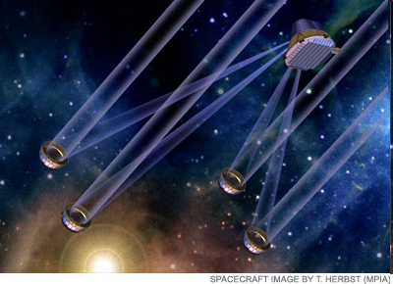
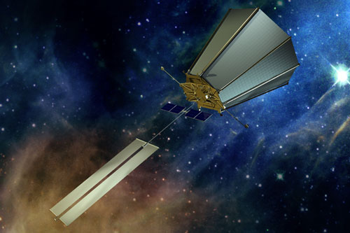
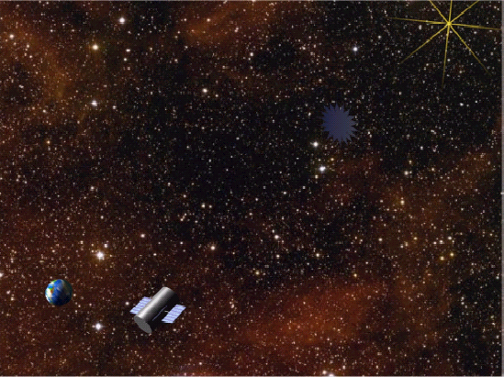
TPF-C
TPF-I/Darwin
What we’d really like to
do is to build a big TPF
(Terrestrial Planet Finder)
telescope and search
directly for Earth-like planets
We can also look for spectroscopic
biomarkers (O₂, O₃, CH₄) and try
to infer whether life is present on such
planets
Given current budget realities in both
Europe and the U.S., these missions
may not happen for a long time, but
smaller versions are being studied
TPF-O

Slide 16
What types of planets do we need to observe?
To answer this, we need to examine the requirements for life…

Slide 17
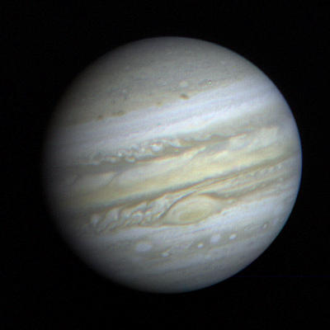
First requirement for life: a liquid or solid surface
It is difficult, or impossible, to imagine how life could get started on a gas giant planet
  Need a liquid or solid surface to provide a stable P/T environment
This requirement is arguably universal

Slide 18
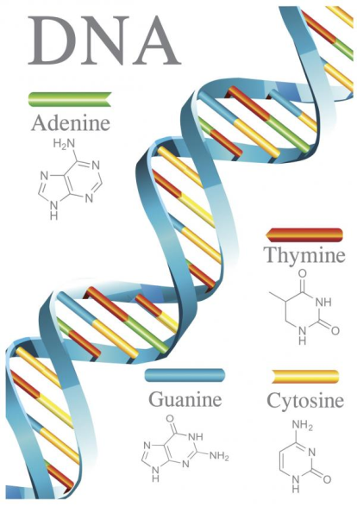
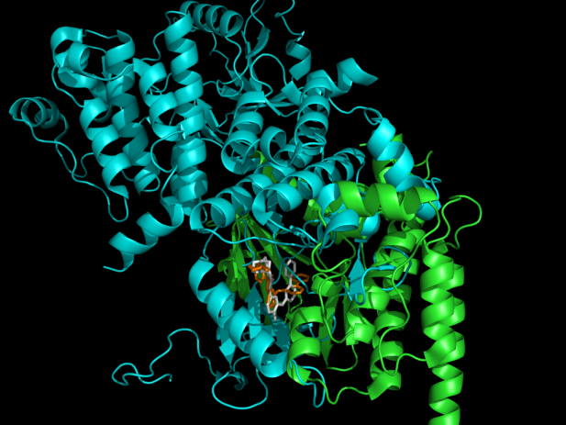
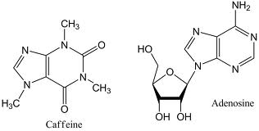
Second requirement for life: carbon
Carbon is unique among the elements in forming long, complex chains
Something like 95% of known chemical compounds are composed of organic carbon
Silicon, which is located right beneath carbon in the Periodic Table, forms strong bonds with oxygen, creating rocks, not life
Proteins

Slide 19
Third requirement for life (as we know it) : Liquid water
Life on Earth requires liquid water during at least part of its life cycle
So, our first choice is to look for other planets like Earth
Subsurface water is not relevant for remote life detection because it is unlikely that a subsurface biota could modify a planetary atmosphere in a way that could be observed (at modest spectral resolution)

Slide 20
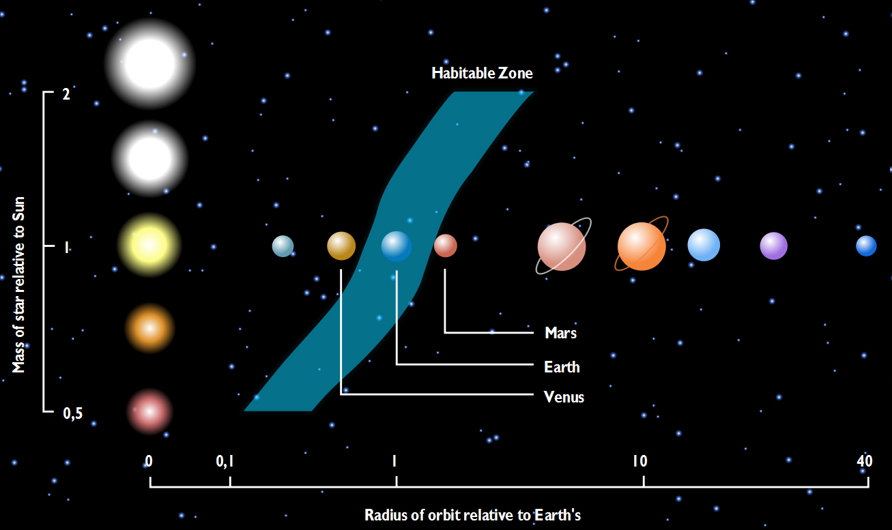
The habitable zone
This leads directly to the concept of the habitable zone, also referred to
as the ecosphere, or (Shapley, 1938) the liquid water belt
Figure applies to zero-age-main-sequence stars; the HZ moves outward
with time because all main sequence stars brighten as they age
http://www.dlr.de/en/desktopdefault.aspx/tabid-5170/8702_read-15322/8702_page-2/

Slide 21
Determining the frequency of Earth-like planets
η_{Earth}—the fraction of stars that have at least one rocky planet in their habitable zone
  This is what we need to know in order to design a space telescope to look for such planets around nearby stars

Slide 22
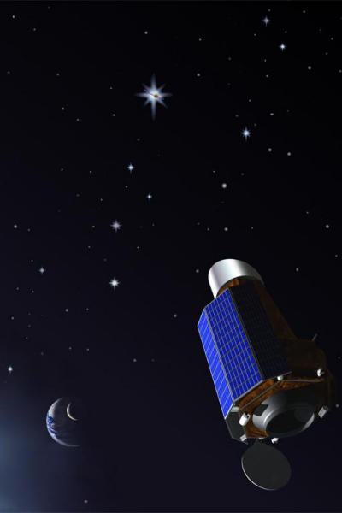
Kepler Mission
This space-based telescope
will point at a patch of the
Milky Way and monitor the
brightness of ~160,000 stars,
looking for transits of Earth-
sized (and other) planets
10⁻⁵ precision photometry
0.95-m aperture ⇒ capable
of detecting Earths
Launched: March 5, 2009
Died (mostly): April, 2013
http://www.nmm.ac.uk/uploads/jpg/kepler.jpg

Slide 23
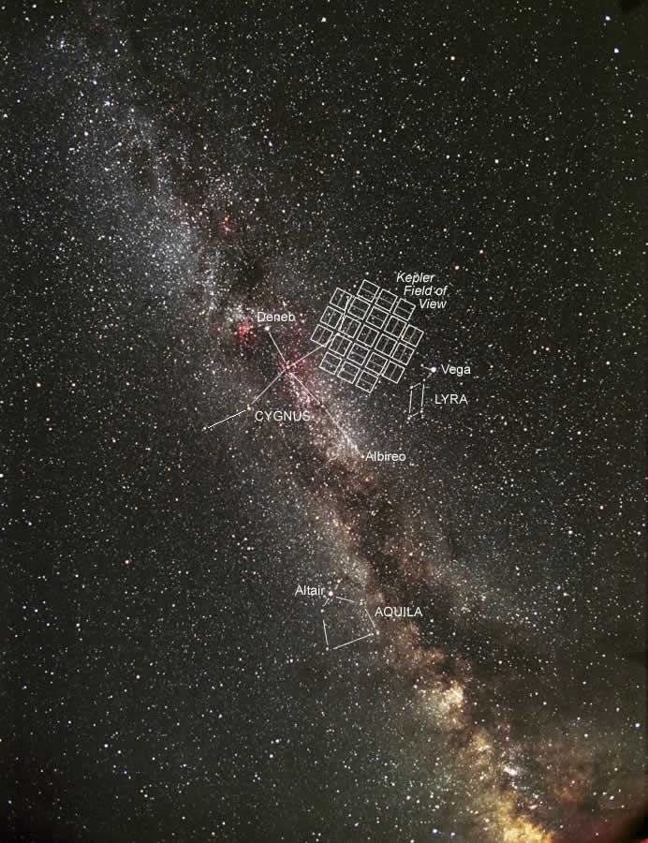
Kepler target field: The stars in this field range from a few
hundred to a few thousand light years in distance

Slide 24
December 2011 Kepler data release
Candidate label | Candidate size (R_{E}) | Number of candidates
Earth-size | R_{p} < 1.25 | 207
Super-Earths | 1.25 < R_{p} < 2.0 | 680
Neptune-size | 2.0 < R_{p} < 6.0 | 1181
Jupiter-size | 6.0 < R_{p} < 15 | 203
Very-large-size | 15 < R_{p} < 22.4 | 55
TOTAL |  | 2326
Planets bigger than about 2 Earth radii (~10 Earth masses) are expected
to capture gas during their formation and turn into gas or ice giants
• The Earth’s and super-Earths are potentially habitable

Slide 25
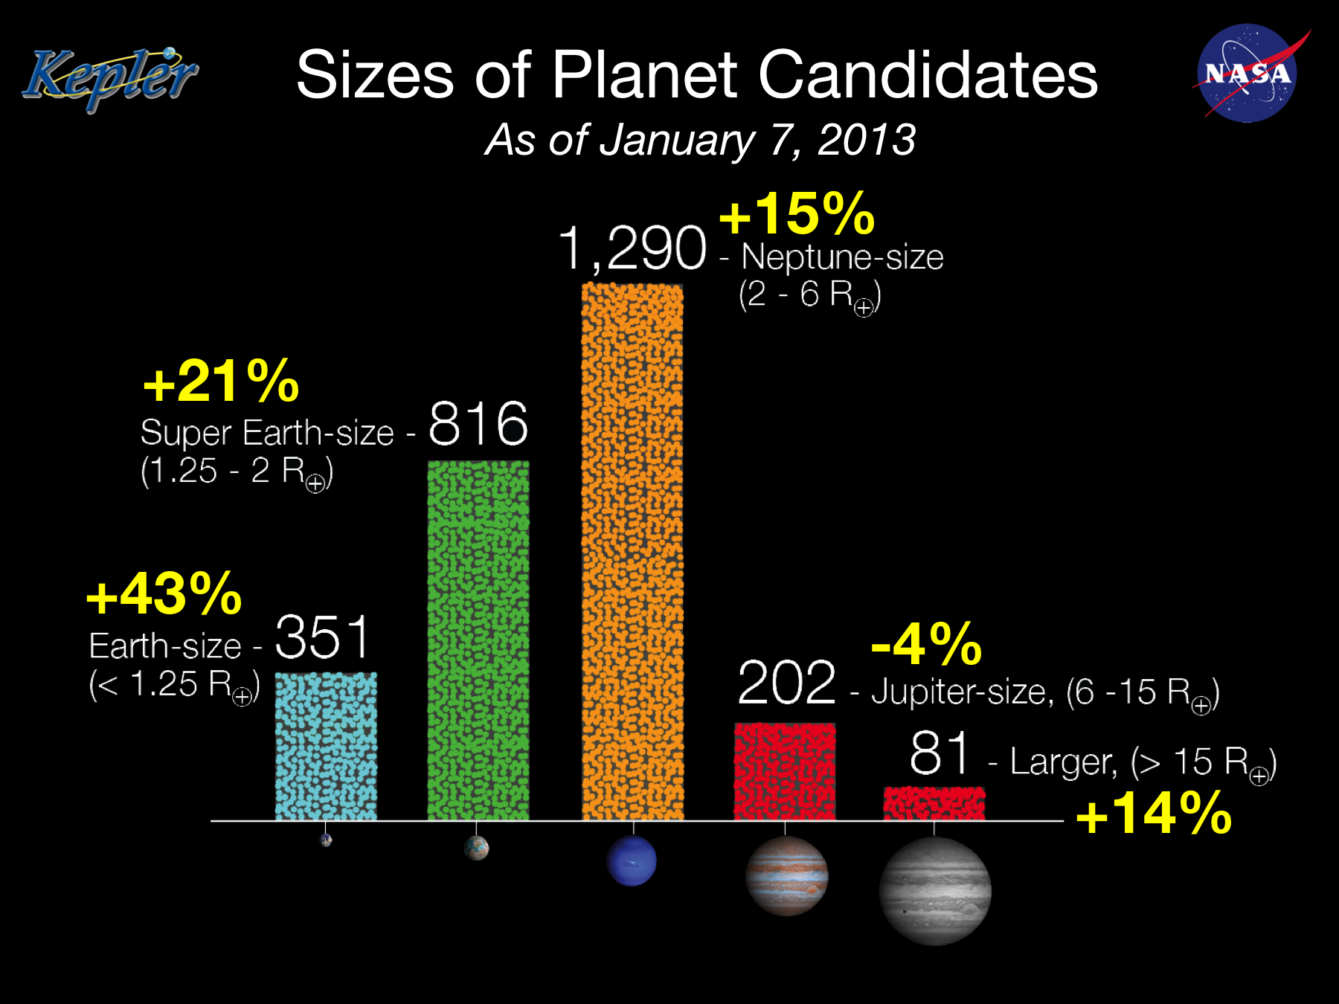
Source: Christopher Burke, AAS presentation, Long Beach, CA, Jan. 7, 2013

Slide 26
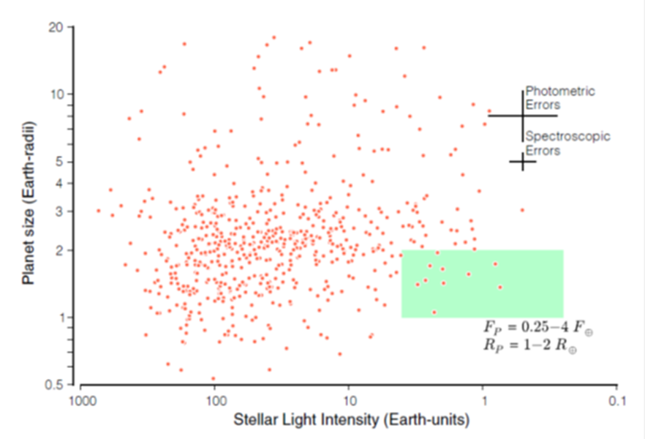
Published η_{Earth} estimates
Recently, Petigura et al. published an estimate of η_{Earth} for K stars and (one)
late-G star
They got 0.22, but they assumed a HZ of 0.5-2.0 AU, which is too wide, so a conservative estimate might be ~0.1
By comparison, published estimates of η_{Earth} for M stars are of the order of 0.4-0.6 (Kasting et al., PNAS, 2014, and refs. therein)
0.5
1.0
2.0
AU
Petigura et al., PNAS (2013)

Slide 27
Conclusions
CO could have been an important source of metabolic free energy for early organisms
The early Earth was relatively cool by 2.9 Ga, but it could have been hot earlier in its history
  That said, hyperthemophilia near the base of the rRNA tree could be explained if early life was confined to hydrothermal vents
Earth-like planets appear to be reasonably abundant around various classes of main sequence stars
Ultimately, we need to fly some kind of TPF mission to directly image Earth-sized planets, to characterize their atmospheres, and to look for evidence of life
  If we find it, we will know that the origin of life is not a rare event, and that, in turn, could help us determine how it happened

