Slide 1
Insights from genetic information: experimental evidence of the thermophilicity of ancestral life
2014. 09. 26 Oparin International Conference
Moscow
Tokyo Univ. Pharmacy and Life Sci.
Akihiko Yamagishi

Slide 2
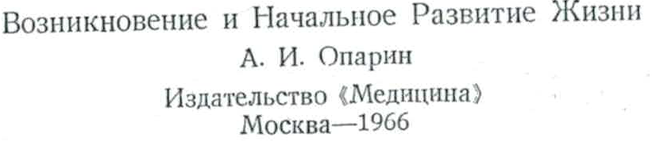
Origin of Life: Emergence and early development of life.
Oparin
Japanese translation published in 1969

Slide 3
Content
１. Phylogenetic analysis
２．Ancestral mutants
３．Ancestral enzyme

Slide 4
１． Phylogenetic analysis
The way of analysing the history of life
Amino acid sequences of the gene of hemoglobin
human VLSPADKTNVKAAWGKVGAHAGEYGAEALERMFLAFPTTKTYFPHF
horse VLSAADKTNVKAAWSKVGGHAGEYGAEALERMFLGFPTTKTYFPHF
carp SLSDKSKAAVKIAWAKISPKADDIGAEALGRMLTVYPQTKTYFAHW
By comparing the sequence of genes, you can infer the phylogenetic tree.
human
horse
carp

Slide 5
１． Phylogenetic analysis
Phylogenetic tree of all the organisms
purple bacteria 60
mitochondria 55
Gram-positive bacteria 65
Bacteria
cyanobacteria 65
chloroplasts 45
(Eubacteria)
Thermus
75
green non-sulfur bacteria 60
Thermotoga
80
Origin of life
Apuifex
85
Sulfolobus
80
Crenarchaeota
Pyrodictium
105
P
Thermoproteus
88
Thermococcus
88
Methanococcus
88
Archaea
Methanobacterium
(Archaebacteria)
70
Thermoplasma
60
Euryarchaeota
extreme halophiles 55
Methanosarcina
40
(Commonote or LUCA)
Methanospirillum
37
The last common ancestor
microsporidia
P'
flagellates
Eucarya
(Eukaryotes)
animals
Woese et al. 1990
plants
fungi 55

Slide 6
１． Phylogenetic analysis

Slide 7
１． Phylogenetic analysis
General phylogenetic tree
with optimum growth temperature
4 Ga
3.8 Ga
purple bacteria 60
mitochondria 55
Gram-positive bacteria 65
Bacteria
cyanobacteria 65
chloroplasts 45
(Eubacteria)
Thermus
75
green non-sulfur bacteria 60
Thermotoga
80
Origin of life
Apuifex
85
Sulfolobus
80
Crenarchaeota
Pyrodictium
105
P
Thermoproteus
88
Thermococcus
88
Methanococcus
88
Archaea
Methanobacterium
(Archaebacteria)
70
Thermoplasma
60
Euryarchaeota
extreme halophiles 55
(Commonote or LUCA)
Methanosarcina
40
Methanospirillum
37
The last common ancestor
microsporidia
P'
flagellates
Eucarya
(Eukaryotes)
animals
plants
fungi 55

Slide 8
１． Phylogenetic analysis
Thermophilic and hyperthermophilic universal common ancestor hypothesis
Woese, C. R. (1987) suggested that thermophilisity is ancestral characteristics of prokaryotes.
Stetter, K.O., and Pace, N. R. (1991) proposed the hyperthermophilic universal common ancestor.
Nisbet, E. G. and Fowler, C. M. R. (1996) suggested the hot origin of life from geological point of view.

Slide 9
１． Phylogenetic analysis
Arguments against the hyperthermophilic common ancestor hypothesis.
・Miller, S. L. & Lazcano, A. (1995) analyzed the
stability of biological compound, suggesting that
origin of life can not be hot.
・Forterre, P. (1996) criticized the interpretation of the
phylogenetic tree: hyperthermophiles could be
selected after branching into several species, thus
the common ancestor may be mesophilic.
・Galtier, N., Taurasse, N. & Gouy, M. (1999)
estimated GC-content of rRNA gene of the
universal common ancestor. The GC content,
which is correlated with growth temperature, was
too low to be a hyperthermophile.

Slide 10
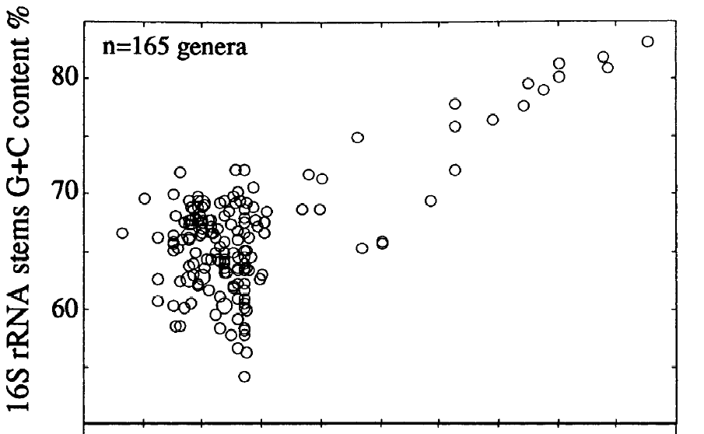
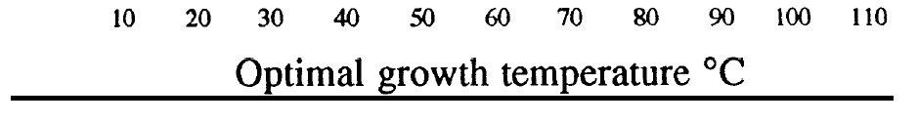
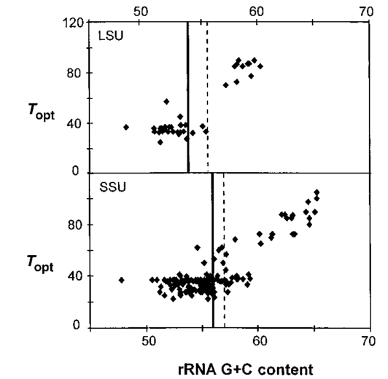
G+C content of rRNA is related to growth temperature .
１． Phylogenetic analysis
N. Galtier and J. R. Lobry (1997)
The G+C nucleotide content of ribosomal RNA (rRNA) sequences is strongly correlated with the optimal growth temperature (OGT) of prokaryotes.
N. Galtier, N. Tourasse, M. Gouy (1999)
The inferred G+C content of small sub-unit rRNA and large sub-unit rRNA of the common ancestor to extant life forms appeared incompatible with survival at high temperature.

Slide 11
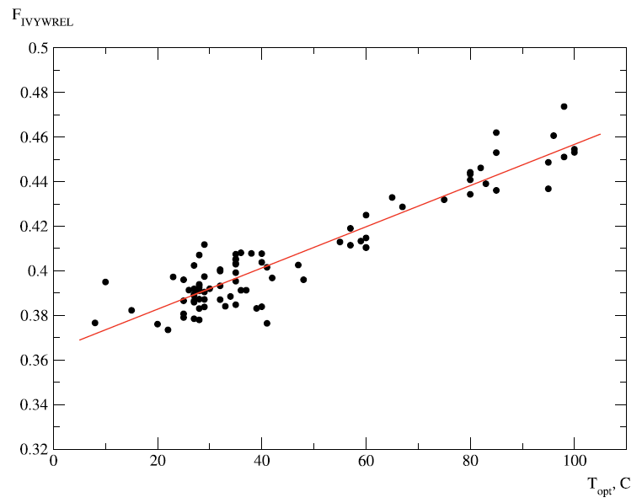
Content of amino acid species （IVYWREL)
１． Phylogenetic analysis
K. Zeldovich et. al. (2007)
The total concentration of seven amino acids in proteomes (IVYWREL) serves as a universal proteomic predictor of OGT in prokaryotes, and the correlation coefficient is as high as 0.93.
IVYWREL content in proteome
Optimum growth temperature ( C)
o

Slide 12
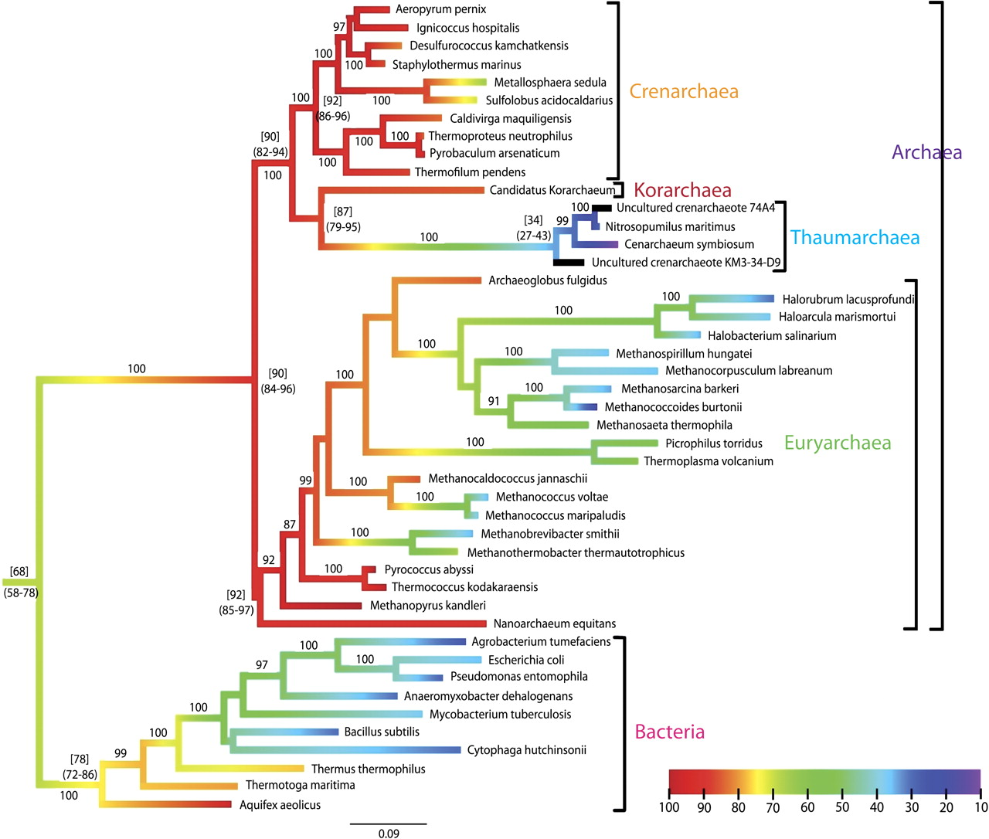
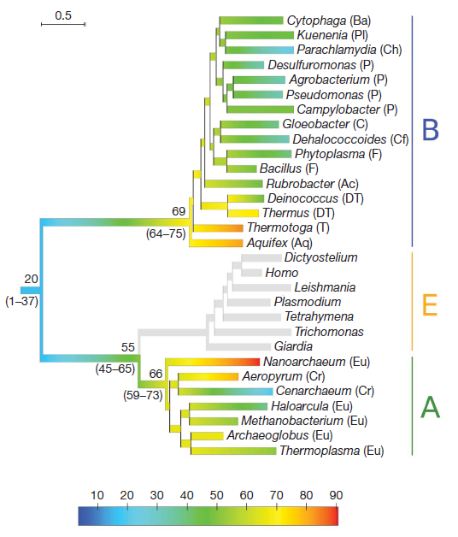
Estimation of common ancestor from amino acid content.
１． Phylogenetic analysis
M. Groussin and M Gouy (2011)
Non-(hyper)thermophilic common ancestor (20 ºC)
48 ºC difference
Thermophilic common ancestor (68 ºC)
B. Boussau et al (2008)

Slide 13
Content
１. Phylogenetic analysis
２．Ancestral mutants
３．Ancestral enzyme

Slide 14
Experimental test of the hypothesis, using an enzyme.
2．Ancestral mutants
Construction of multiple sequence alignment and a phylogenetic tree.
(2) Inference of ancestral amino acid.
(3) Construction of ancestral mutants.
(4) Expression and purification of ancestral mutants
(5) Analysis of the thermo-stability

Slide 15
2．Ancestral mutants
Phylogenetic tree of twin enzymes, IPMDHs and ICDHs
Archaea
ICDH
Bacteria
Archaea
IPMDH
Bacteria
IPMDH: 3-isopropylmalate dehydrogenase, in leucine biosynthesis.
ICDH: isocitrate dehydrogenase in glutamate biosynthesis.

Slide 16
2．Ancestral mutants
Multiple alignment of IPMDHs and ICDHs
85 97 149 158 253 285
IB.sub .IRKQLDLFANLRP...RVIREGFKMA...FEPVHGSAPDIAGKGMANPFAAILSAAMLLRTS..
IE.col .LRKHFKLFSNLRP...RIARIAFESA...YEPAGGSAPDIAGKNIANPIAQILSLALLLRYS..
IA.tum .LRKDLELFANLRP...RIASVAFELA...YEPVHGSAPDIAGKSIANPIAMIASFAMCLRYS..
IS.cer .IRKELQLYANLRP...RITRMAAFMA...YEPCHGSAPDL-PKNKVNPIATILSAAMMLKLS..
IN.cra .LRKELGTYGNLRP...RIARLAGFLA...YEPIHGSAPDISGKGIVNPVGTILSVAMMLRYS..
IT.the .LRKSQDLFANLRP...RVARVAFEAA...FEPVHGSAPDIAGKGIANPTAAILSAAMMLEHA..
ISul#7 .LRQIYDMYANIRP...RIAKVGLNFA...FEPVHGAAFDIAGKNIGNPTAFLLSVSMMYERM..
CB.tau .LRKTFDLYANVRP...RIAEFAFEYA...FESVHGTAPDIAGKDMANPTALLLSAVMMLRHM..
CS.cer .LRKTFGLFANVRP...RVIRYAFEYA...FEAVHGSAPDIAGQDKANPTALLLSSVMMLNHM..
CB.sub .LRQELDLFVCLRP...RLVRAAIDYA...FEATHGTAPKYAGLDKVNPSSVILSGVLLLEHL..
CE.col .LRQELDLYICLRP...RLVRAAIEYA...FEATHGTAPKYAGQDKVNPGSIILSAEMMLRHM..
# # # # ** * ** *
Ancest .LRxxxDLxANLRP...RIARxAFExA...FExVHGSAPDIAGKxxxNPTAxxLSxxMMLxxx..
M91L K152R A259S Y282L
I95L G154A F261P
Ancest: The ancestral sequence inferred.

Slide 17
2．Ancestral mutants
The way of inferring the ancestral amino acid residues which are possessed by the common ancestor by parsimony.
R
R
R/S
R
S
R
R
R
R
R/K
R
IPMDH
R
K
Sulfolobus tokodaii
R
E
E/R
R
R
R
ICDH
R
R
R
R

Slide 18
2．Ancestral mutants
Multiple alignment of IPMDHs and ICDHs
85 97 149 158 253 285
IB.sub .IRKQLDLFANLRP...RVIREGFKMA...FEPVHGSAPDIAGKGMANPFAAILSAAMLLRTS..
IE.col .LRKHFKLFSNLRP...RIARIAFESA...YEPAGGSAPDIAGKNIANPIAQILSLALLLRYS..
IA.tum .LRKDLELFANLRP...RIASVAFELA...YEPVHGSAPDIAGKSIANPIAMIASFAMCLRYS..
IS.cer .IRKELQLYANLRP...RITRMAAFMA...YEPCHGSAPDL-PKNKVNPIATILSAAMMLKLS..
IN.cra .LRKELGTYGNLRP...RIARLAGFLA...YEPIHGSAPDISGKGIVNPVGTILSVAMMLRYS..
IT.the .LRKSQDLFANLRP...RVARVAFEAA...FEPVHGSAPDIAGKGIANPTAAILSAAMMLEHA..
ISul#7 .LRQIYDMYANIRP...RIAKVGLNFA...FEPVHGAAFDIAGKNIGNPTAFLLSVSMMYERM..
CB.tau .LRKTFDLYANVRP...RIAEFAFEYA...FESVHGTAPDIAGKDMANPTALLLSAVMMLRHM..
CS.cer .LRKTFGLFANVRP...RVIRYAFEYA...FEAVHGSAPDIAGQDKANPTALLLSSVMMLNHM..
CB.sub .LRQELDLFVCLRP...RLVRAAIDYA...FEATHGTAPKYAGLDKVNPSSVILSGVLLLEHL..
CE.col .LRQELDLYICLRP...RLVRAAIEYA...FEATHGTAPKYAGQDKVNPGSIILSAEMMLRHM..
# # # # ** * ** *
Ancest .LRxxxDLxANLRP...RIARxAFExA...FExVHGSAPDIAGKxxxNPTAxxLSxxMMLxxx..
M91L K152R A259S Y282L
I95L G154A F261P
- Ancest: The ancestral sequence inferred.
- Isul#7: IPMDH of an hyper-thermophile, Sulfolobus tokodaii. Most of the residues are conserved and are shown in yellow. Some are not, and are shown in green.
- Ancest residues shown in pink, were introduced as mutation, starting from contemporary hyperthermophile enzyme Isul#7.

Slide 19
Denaturation curve of the wild type and ancestral mutants of S.tokodaii IPMDH estimated by CD at 222nm.
2．Ancestral mutants
5/7 mutants showed higher thermal stability than the wild type.
Miyazaki et al. J. Biochem (2001). 129, 777-782

Slide 20
2．Ancestral mutants
We inferred the ancestral sequence and analyzed the enzymes.
1. Sulfolobus tokodaii IPMDH :Hyperthermophilic archaeon
5/7 ancestral mutants showed higher thermostability than the
wild-type IPMDH.
2. Caldococcus noboribetus ICDH: Hyperthermophilic archaeon
4/5 ancestral mutants showed higher
thermostability than the wild-type ICDH.
3. Thermus thermophilus IPMDH:Thermophilic bacteria
6/12 ancestral mutants showed higher
thermostability than the wild-type IPMDH.
4. Thermus thermophilus Gly-RS:Thermophilic bacteria
6/8 ancestral mutants showed higher
thermostability than the wild-type Gly-RS.

Slide 21
Lesson 1.
2．Ancestral mutants
1. The last common ancestor was a hyper-themophile.

Slide 22
Content
１. Phylogenetic analysis
２．Ancestral mutants
３．Ancestral enzyme

Slide 23
4. Ancestral enzyme
3．Ancestral enzyme
Total synthesis of ancestral genes.
S. Akanuma, Y.Nakajima, S.Yokobori, M. Kimura, N. Nemoto, T. Mase, K.Miyazono, M. Tanokura, A. Yamagishi (2013) Proc. Natl. Acad. Scie. USA. 110, 11067-11072

Slide 24
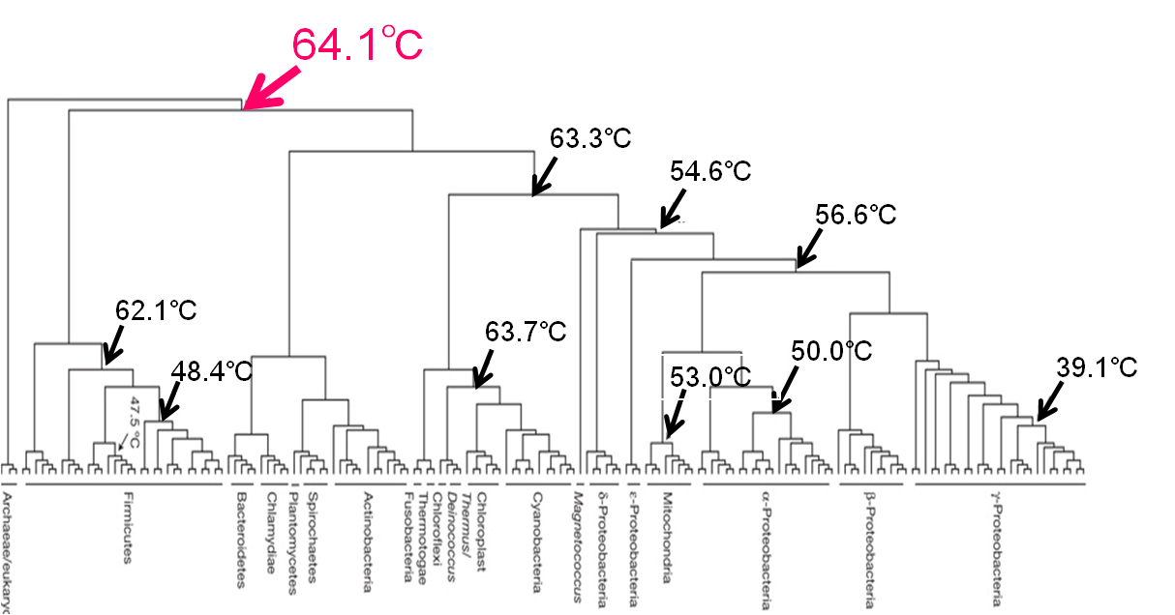
Bacterial ancestor.
3．Ancestral enzyme
We decided to make archaeal ancestor as well as bacterial ancestore.
E.A. Gaucher et al. (2003, 2008)
The thermostabilities of resurrected ancient bacterial EF-Tu suggest that the bacterial common ancestor (BCA) was thermophilic organism but not hyperthermophilic one.
The phylogenetic tree of bacterial EF-Tu and melting temperatures for ancient EF proteins
This protein’s host organism was thermophilic
BCA

Slide 25
NDK is an enzyme involved in nucleotide synthesis.
3．Ancestral enzyme
Material
Nucleoside diphosphate kinase (NDK)
N
P
P
P
NDK
N
P
N
P
P
NDK
P
P
N: nucleoside
P: phosphate
NDK
N
P
P
P

Slide 26
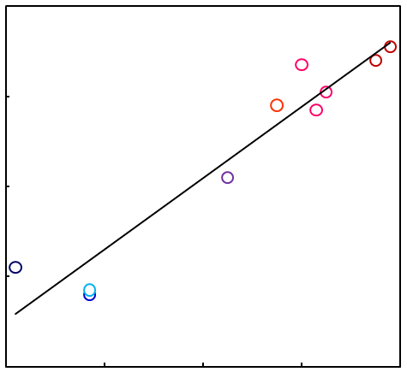
3．Ancestral enzyme
Relation between growth temperature and stability of protein
120
P. horikoshii
S. tokodaii
A. pernix
100
M. jannaschii
T. thermophilus
A. fulgidus
80
M. thermautotrophicus
Unfolding midpoint temperature (ºC)
D. discoideum
60
B. subtilis
E. coli
20
40
40
60
80
100
Optimal Growth Temperature (ºC)

Slide 27
Whole-gene synthesis of ancestral sequence.
3．Ancestral enzyme
Construction of multiple sequence alignment and a phylogenetic tree.
(2) Inference of ancestral amino acid.
(3) Whole-gene synthesis of ancestral sequence.
(4) Expression and purification of ancestral protain
(5) Analysis of the thermo-stability

Slide 28
3．Ancestral enzyme
Programs used for the phylogenetic analysis
 | Program used | Name of reconstructed protein
Archaeal ancestor | CODEML in PAML | Arc1
 | nhPhyloBayes | Arc2
Bacterial ancestor | CODEML in PAML | Bac1
 | nhPhyloBayes | Bac2
Whole-gene synthesis using synthetic DNA and PCR.
Express the gene in E. coli and purify the enzymes.
Notes:
28

Slide 29
NDKs of Archaeal (Red) and Bacterial (Blue) ancestors.
3．Ancestral enzyme
NDK ML tree
(non-constrained)
NDK ML tree
(constrained)
16S rRNA ML tree
Arc5
Arc3
Arc4
Bac5
Bac3
Bac4

Slide 30
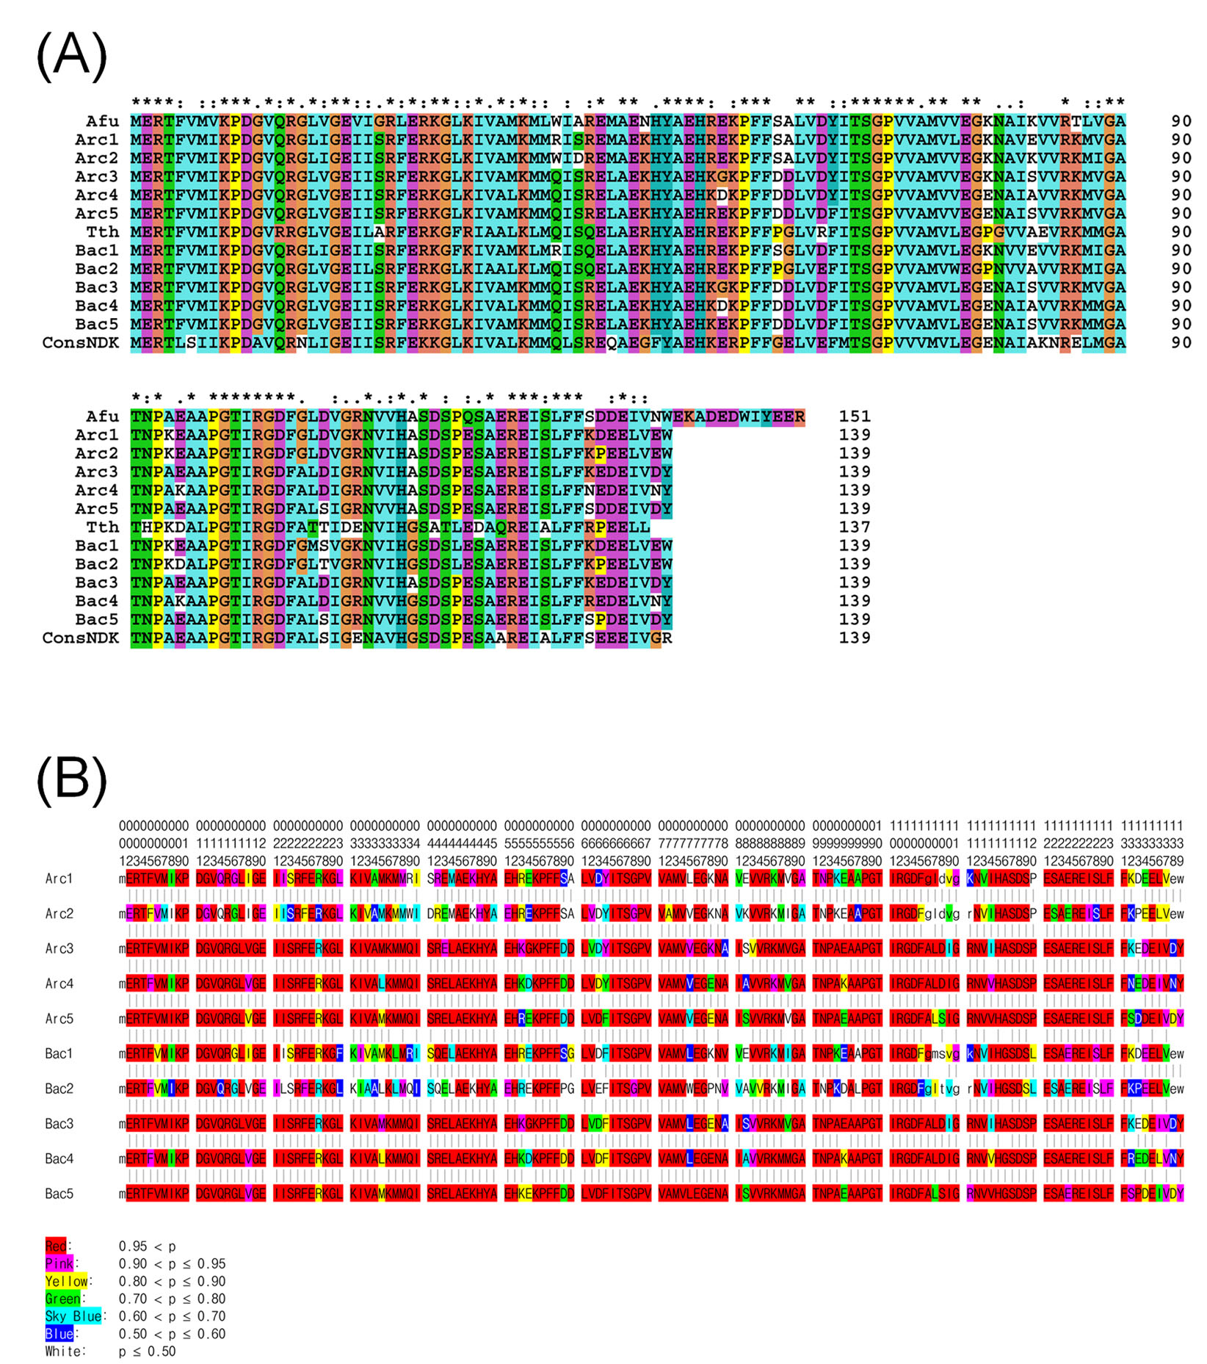
The sequences of ancestral NDKs were synthesized and introduced into E. coli and the proteins were produced in E. coli cells and purifed.
3．Ancestral enzyme

Slide 31
Thermal stabilities of ancestral NDKs: T ( C)
3．Ancestral enzyme
o
m

Slide 32
Thermal stability of NDKs and the optimal growth temperatures.
3．Ancestral enzyme
NDK of Bacterial ancestor：98-109℃
NDK of Archaeal ancestor：99-114℃
Growth temperature of Bacterial ancestor：80-93℃
Growth temperature of Archaeal ancestor：81-97℃

Slide 33
Common ancestor of all the organisms must be between Archaeal and Bacterial ancestors.
3．Ancestral enzyme
Two ancestral NDKs differ 24 amino residues one another.
24 mutants of Bac4 each having each of different amino acid residue were produced and analyzed.
Bac4 mutants with neighboring multiple amino acid residues were produced and analyzed.

Slide 34
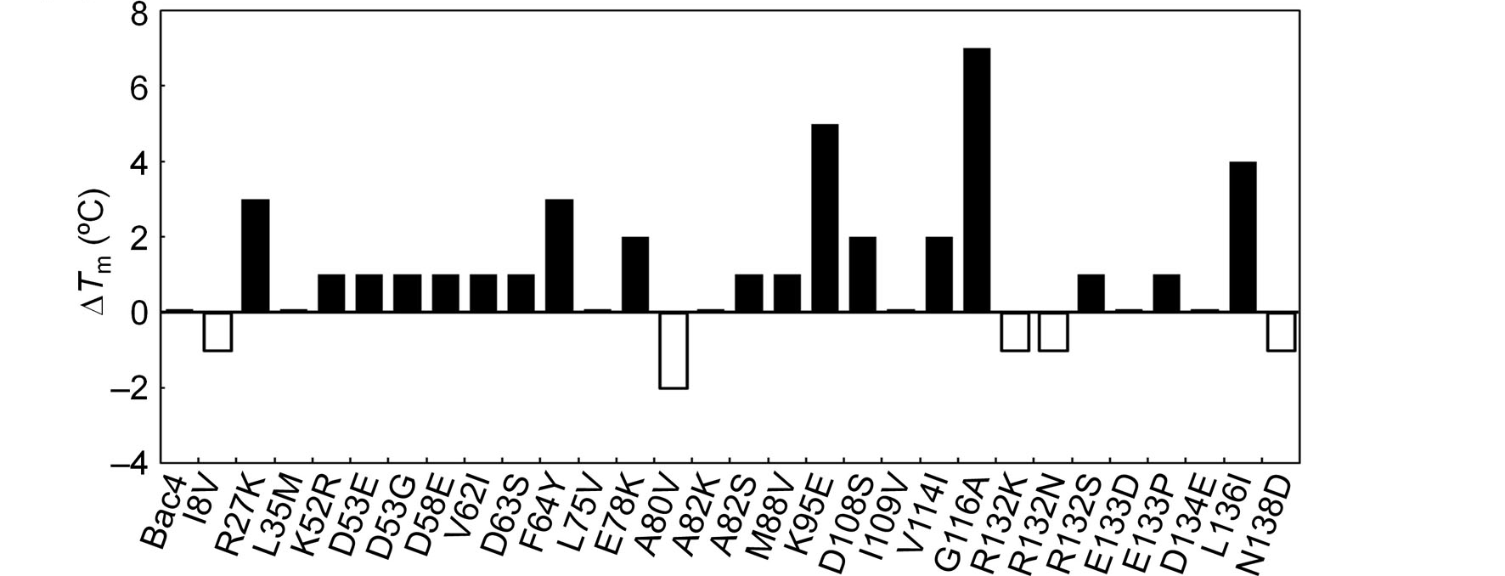
Stability of 24 mutants of Bac4.
3．Ancestral enzyme
＊
＊
＊
＊
＊
5 Bac4 mutants (I8V, A80V, R132K, R132N, N138D) showed stability lower than Bac4.

Slide 35
Bac4 mutants with neighboring residues.
3．Ancestral enzyme
＊
＊
＊
L75V/A80V
＊
＊
R132N/
R132N/
R132N/
２ Bac4 mutants (L75V/A80V, M88V/V114I)showed lower stability.

Slide 36
NDK mutants （Bac4mut7)） possessing all the destabilizing mutations showed stability 95℃, suggesting the optimal growth temperature of the Universal common ancestor 75℃ or higher.
3．Ancestral enzyme

Slide 37
All the ancestral enzymes showed high activity at high temperature.
3．Ancestral enzyme

Slide 38
Lesson 2.
4．If 20 amino acids needed
1. The last common ancestor was hyper-themophile.
2. Growth temperatures of Bacterial ancestor was 80-93℃. Growth temperature of Archaeal ancestor：81-97℃. Growth temperature of the last common ancestor was 75℃ or higher.

Slide 39
Concluding remarks
4．If 20 amino acids needed
Phylogenetic analysis:
1. High ability to resolve the divergence of species.
2．Low resolution in divergence times.
Reproduction of ancient genes:
1. No direct correlation to the fossil record, yet.
2. Good way to get knowledge on the evolution.

Slide 40
Tokyo University of
Pharmacy and Life Science
Yoshiki Nakajima
Jun-ichi Miyazaki
Syu-ichi Nakaya
Hisako Iwabata
Keiko Watanabe
Hideaki Shimizu
Dr. Shin-Ichi Yokobori
Dr. Satoshi Akanuma
Dr. Takatoshi Ohkuri
Dr. Masatada Tamakoshi
Gifu University
Dr. Takashi Yokogawa
Prof.Katuya Nishikawa
Tokyo University
Prof. Yu Tanokura

Slide 41
Thank you!

Slide 42
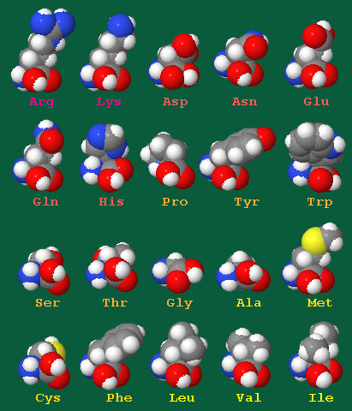
4．If 20 amino acids needed
Wether 20 amino acids are needed of not?

Slide 43
4．If 20 amino acids needed
Before the last common ancestor, number of the amino acid species may not be 20.
Starting from Arc1, which consist of 19 amino acid species, mutants of Arc1, each consists of 18 amino acids was constructed and analyzed.

Slide 44
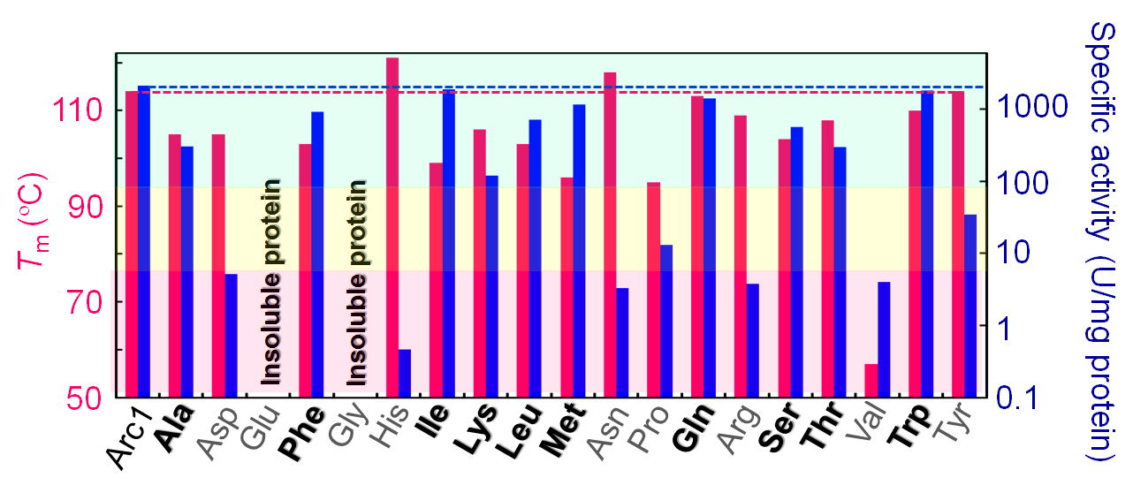
4．If 20 amino acids needed
Thermal stability (red) and activity (blue) of the mutants of Arc1.
Ala, Phe, Ile, Lys, Leu, Met, Gln, Ser, Thr, Trp may not be needed. Glu, Gly, His and Val are needed.

Slide 45
Lesson 3.
4．If 20 amino acids needed
1. The last common ancestor was hyper-themophile.
2．Growth temperatures of Bacterial ancestor was 80-93℃. Growth temperature of Archaeal ancestor：81-97℃. Growth temperature of the last common ancestor was 75℃ or higher.
3. Ala, Phe, Ile, Lys, Leu, Met, Gln, Ser, Thr, Trp may not be needed. Glu, Gly, His and Val were needed.

Slide 46
Effect of amino acid content on stability
 | Protein | Optimum growth temperature (℃） |  | Amino acid cont.
 | stability (℃） | From protain stability | From AA cont.. | ％IVYWREL
Arc3 | 112 | 94 | 45 | 41.007
Arc4 | 104 | 86 | 51 | 41.726
Bac3 | 109 | 91 | 45 | 41.007
Bac4 | 102 | 84 | 45 | 41.007
Arc3nh | 111 | 93 | 51 | 41.726
Arc4nh | 111 | 93 | 65 | 43.165
Bac3nh | 100 | 82 | 59 | 42.446
Bac4nh | 104 | 86 | 79 | 44.604
Lower four ancestral sequences were estimated without the assumption of
conservation of amino acid content. The optimum growth temperatures were within the range, however, those estimated from amino acid contents varied from 45 to 79 and was lower than those experimentally estimated.

Slide 47
3．Ancestral enzyme
Relation between growth temperature and stability of protein
120
P. horikoshii
S. tokodaii
A. pernix
100
M. jannaschii
T. thermophilus
A. fulgidus
80
M. thermautotrophicus
Unfolding midpoint temperature (ºC)
D. discoideum
60
B. subtilis
E. coli
20
40
40
60
80
100
Optimal Growth Temperature (ºC)

Slide 48
余り正確に推定できないアミノ酸がある
それは、２番目の候補も採用する
４．完全祖先型酵素

Slide 49
Content
１. Phylogenetic analysis
２．Ancestral mutants
３．Ancestral enzyme
４. Is 20 amino acid species needed?

