Slide 1
Study of evolutionary mechanisms involved in lipid metabolisms of Chlamydomonas reinhardtii
Jan Fedorko

Slide 2
Introduction
Chlamydomonas reinhardtii is a single-cell algae which is biotechnologically interesting due its ability of accumulation of valuable compounds.
The aim of presented study is to detect phenotype differences between three strains of Chlamydomonas reinhardtii; cc4333 (starchless), cc503 (cell wall deficient) and cc1690 (wild type) with special interest in lipid biosynthesis.
The lipid accumulation under different cultivation conditions was determined by using flow cytometry.

Slide 3
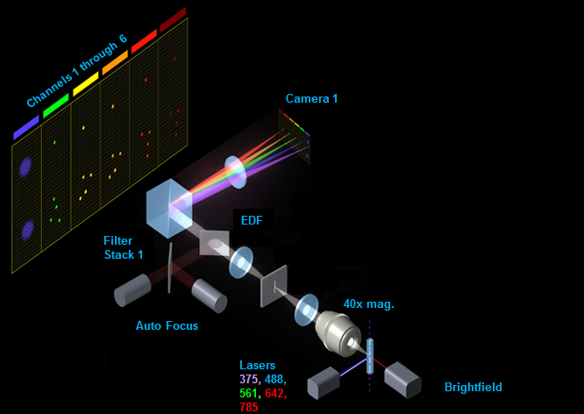
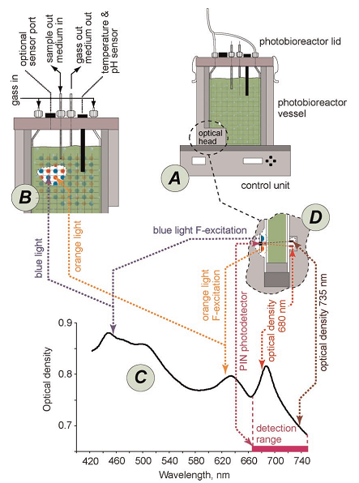
Material and methods
Strains of Chlamydomonas reinhardtii
cc4333 (starchless)
cc503 (cell wall deficient)
cc1690 (wild type)
Devices
Photobioreactor FMT-150
ImageStream^{X} Mark II
Chemicals
Fluorescent dye BODIPY
Culture medium HAP
Fig. 1: Scheme of ImageStream^{X}
Mark II -imaging flow cytometer
Fig. 2: A) The photobioreactor body consists of flat cuvette and control unit. B) Probes for on-line monitoring of temperature, pH and dissolved oxygen and CO₂ take place inside the cuvette. C) and D) depicts cells absorption spectral characteristics and optical sensors properties.

Slide 4
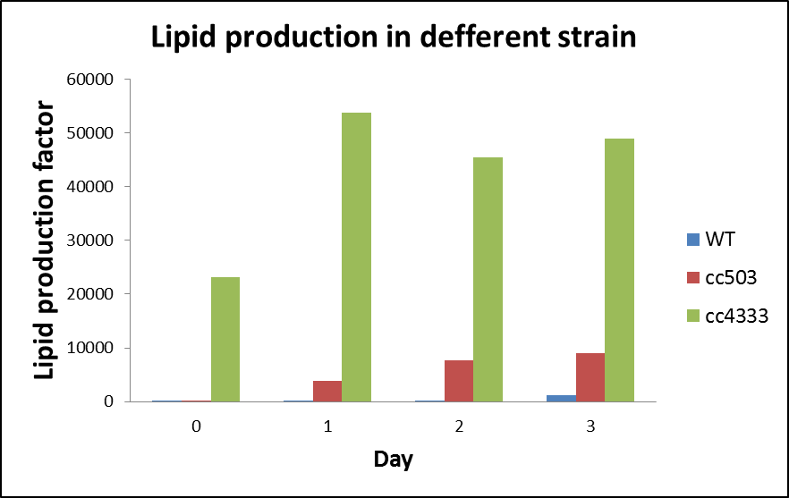
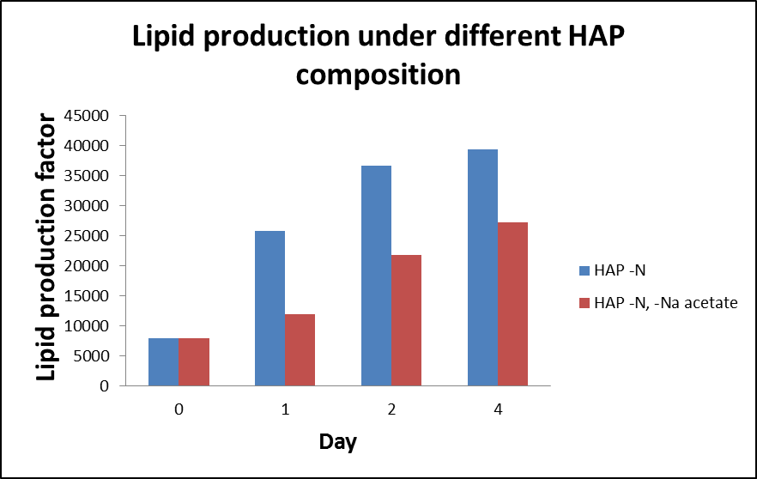
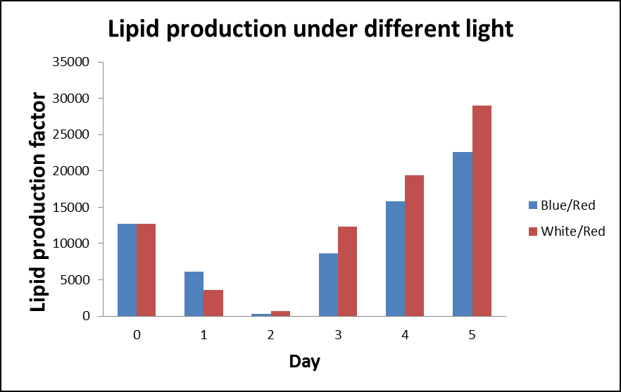
Results
Fig. 3: Lipid production at different strains of Chlamydomonas reinhardtii (blue-WT, red – cell wall deficient and green - strarchless mutant) under nitrogen starvation.
Fig. 4: Lipid production of Chlamydomonas reinhardtii cc4333 strain under nitrogen starvation. Culture medium HAP without nitrogen, with (blue) and without (red) Na acetate.
Fig. 5: Lipid production of Chlamydomonas reinhardtii cc4333 strain under different type of light. As a culture medium was used HAP with nitrogen and Na acetate.

Slide 5
Conclusion and future work
In this study, we confirmed:
Starchless recombinant strain synthesized the most lipid bodies
Presence or absence of Na acetate in the medium has impact on the production of lipids
cc4333 strain enhances lipid production under white-red illumination
In future studies we aim to focus on:
Selection of candidate genes involved in lipid biosynthesis.
Creating sub-population of Chlamydomonas reinhardtii strain with enhanced lipid production.
Sub-population will be selected by cell sorter and its genome sequenced. Function of modified genes will be verified by reverse genetics.

Slide 6
Thank you for your attention fedorko.j@czechglobe.cz

